Slide 1
Intro
6 / 24 / 19

Slide 2
Welcome to CS 61A!!

Slide 3
61A Community

Slide 4
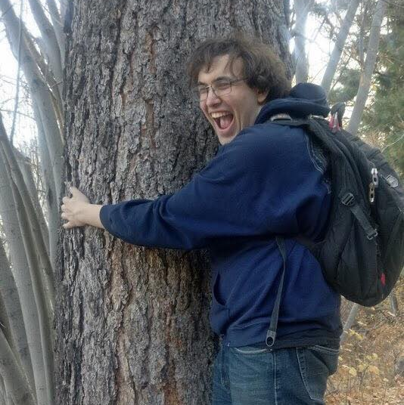


Instructors
Chris Allsman
Tiffany Perumpail
Alex Stennet
cs61a+su19@berkeley.edu

Slide 5
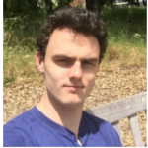
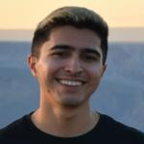
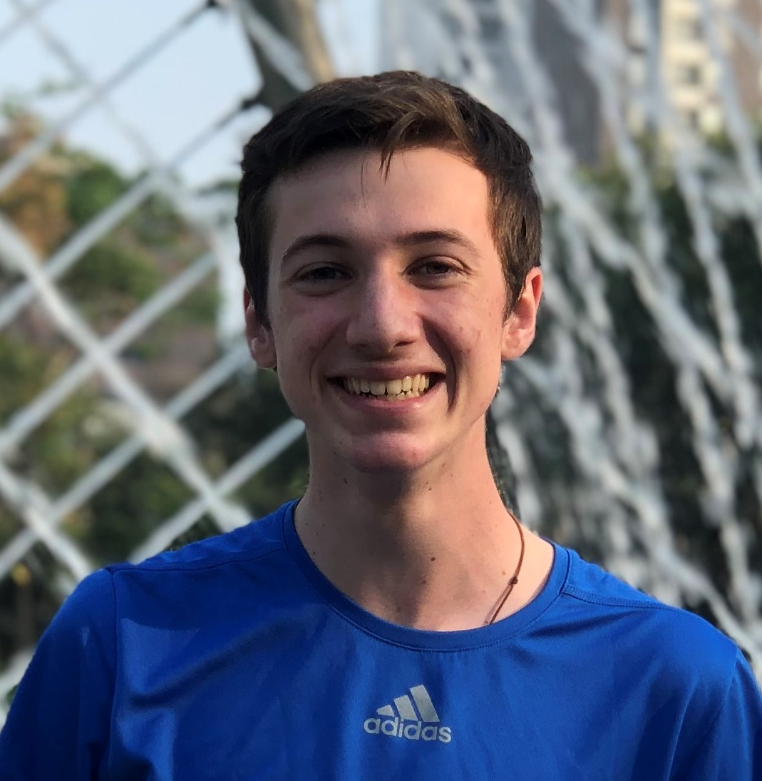
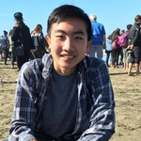

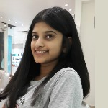
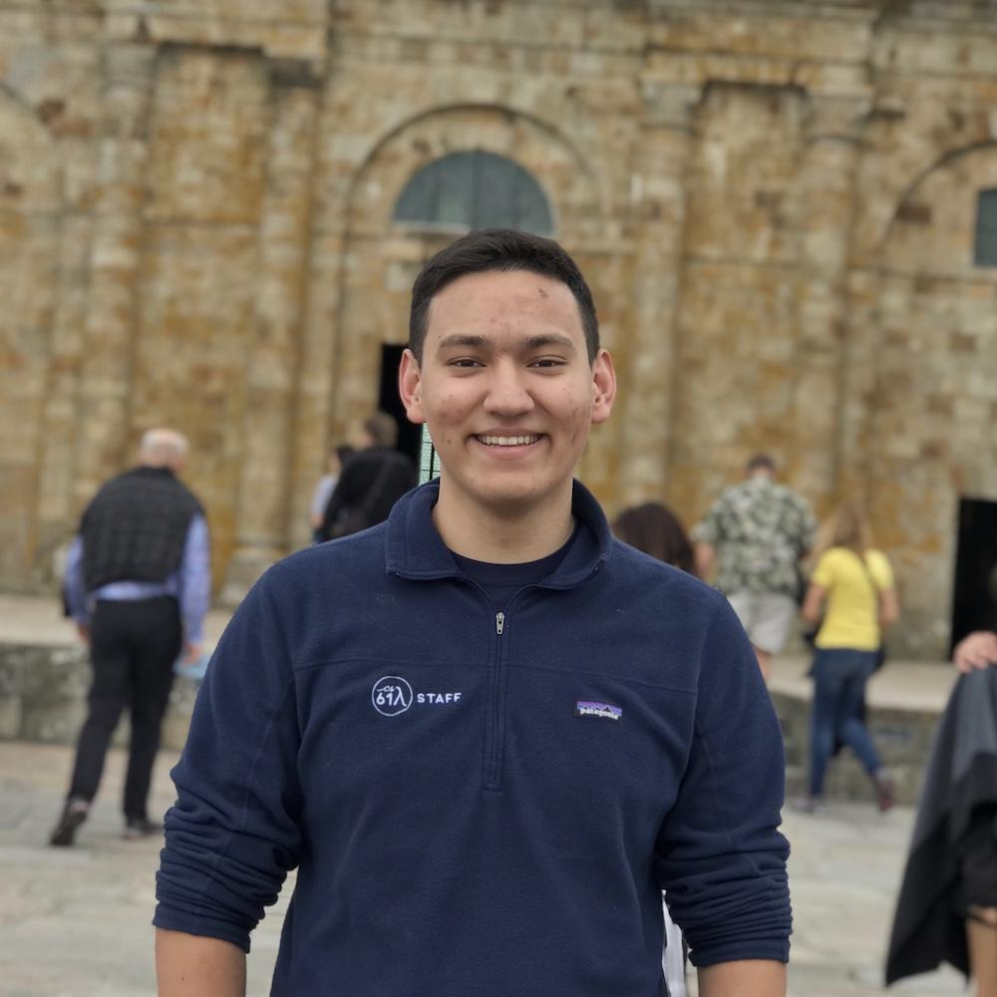
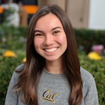

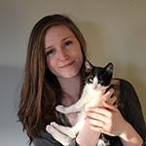
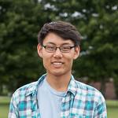
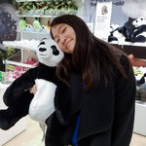
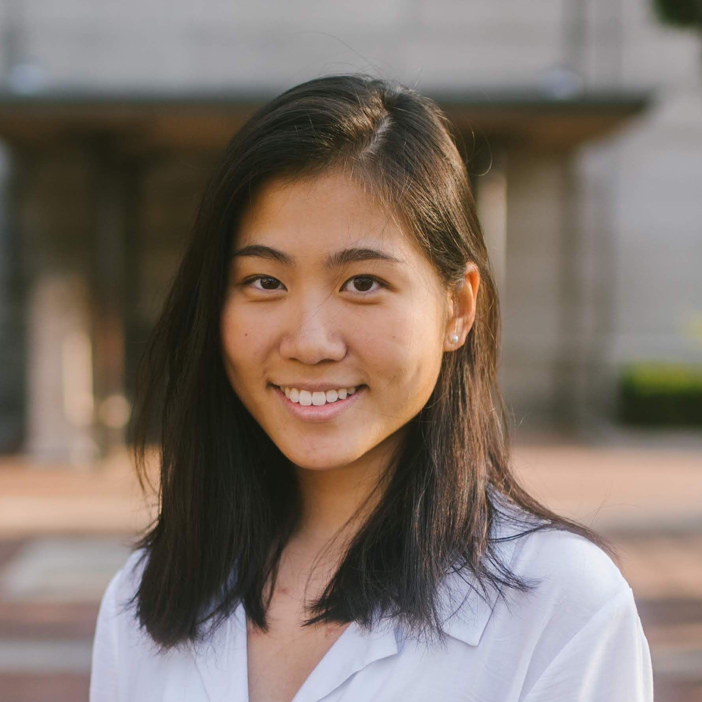
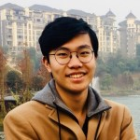
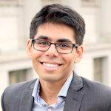
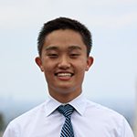

TAs

Slide 6
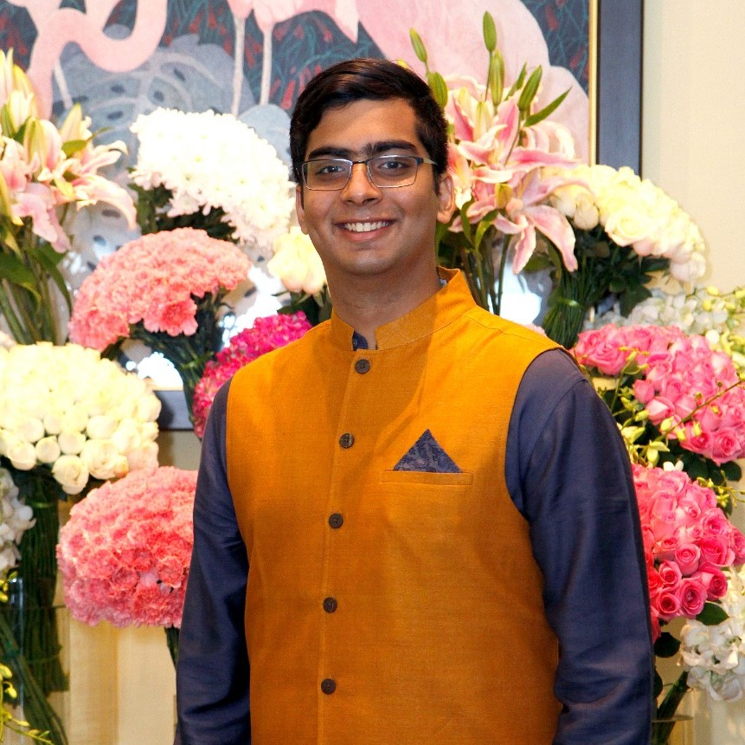
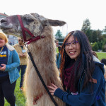
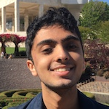
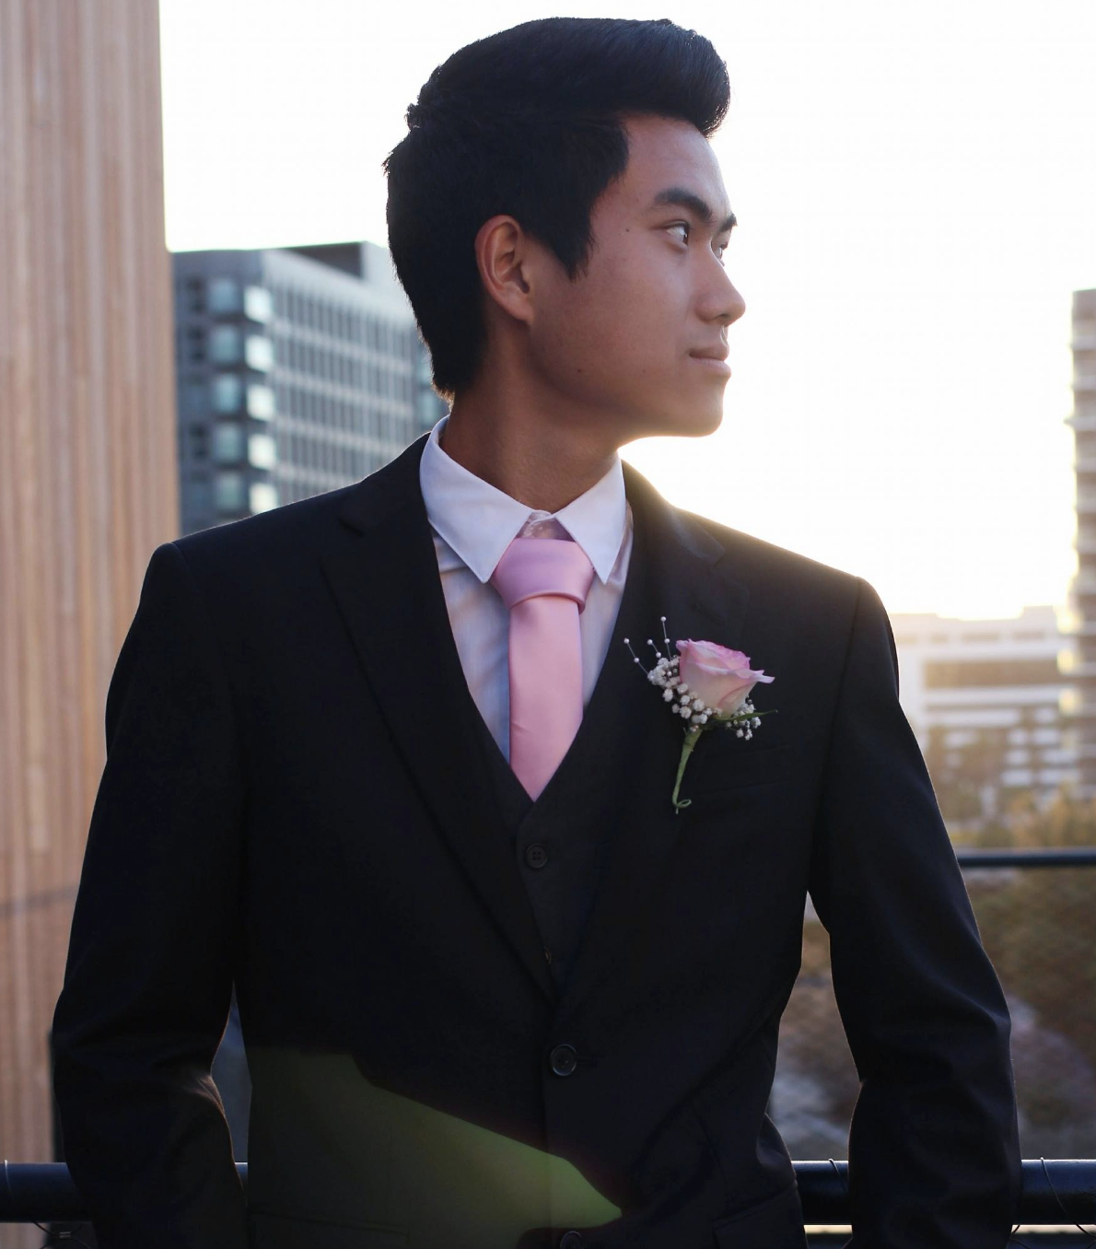
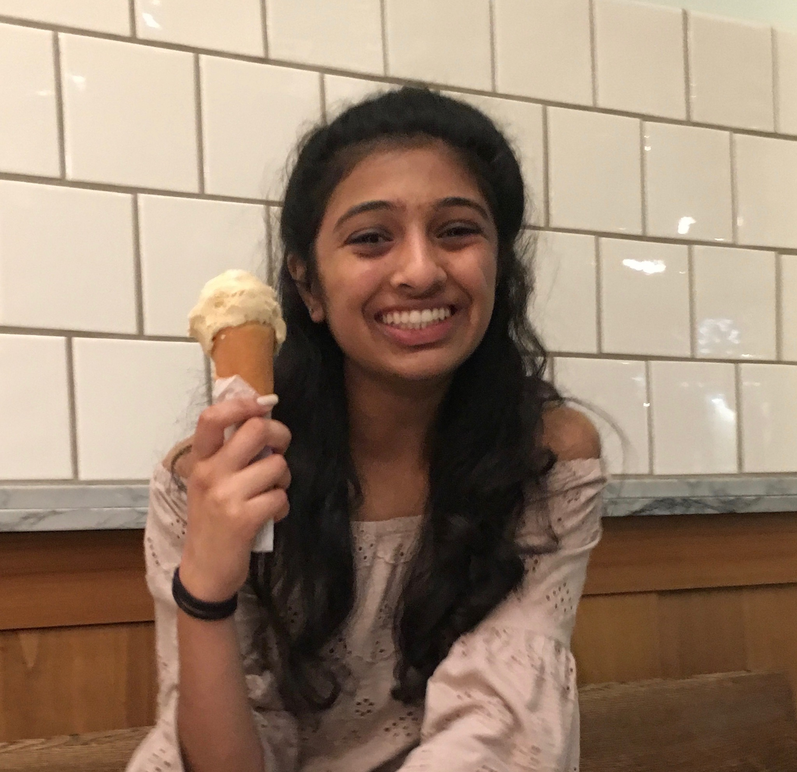
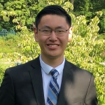
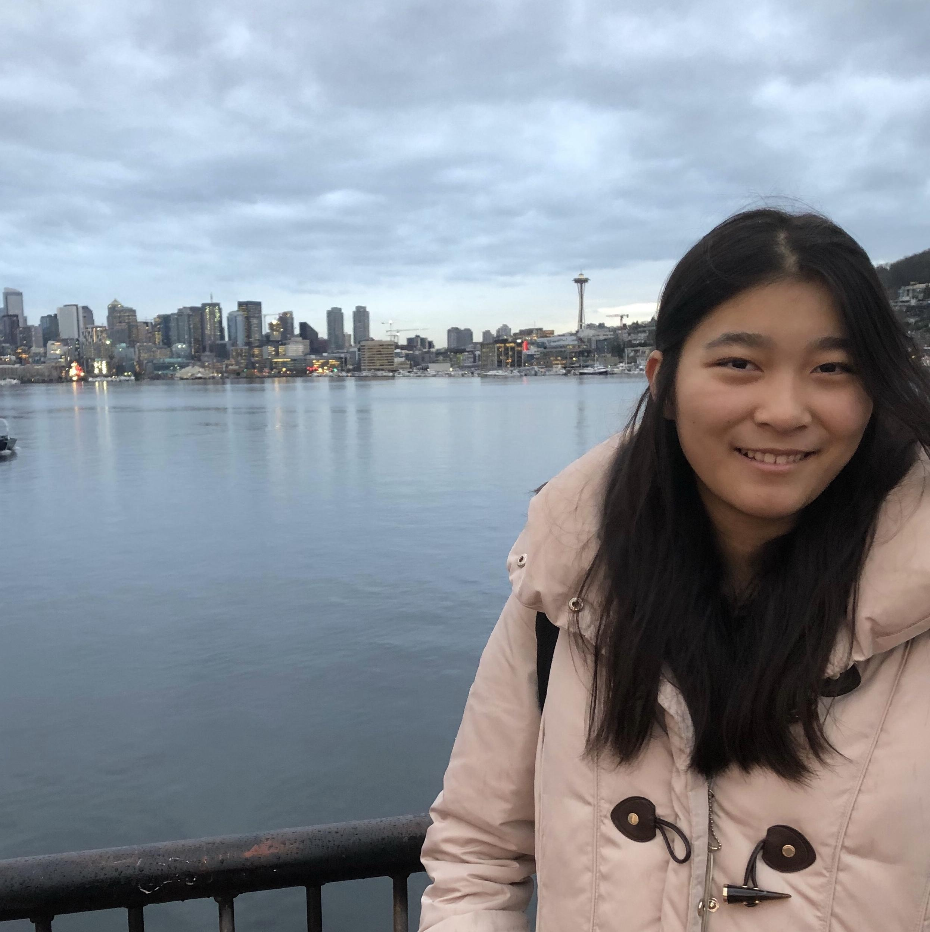

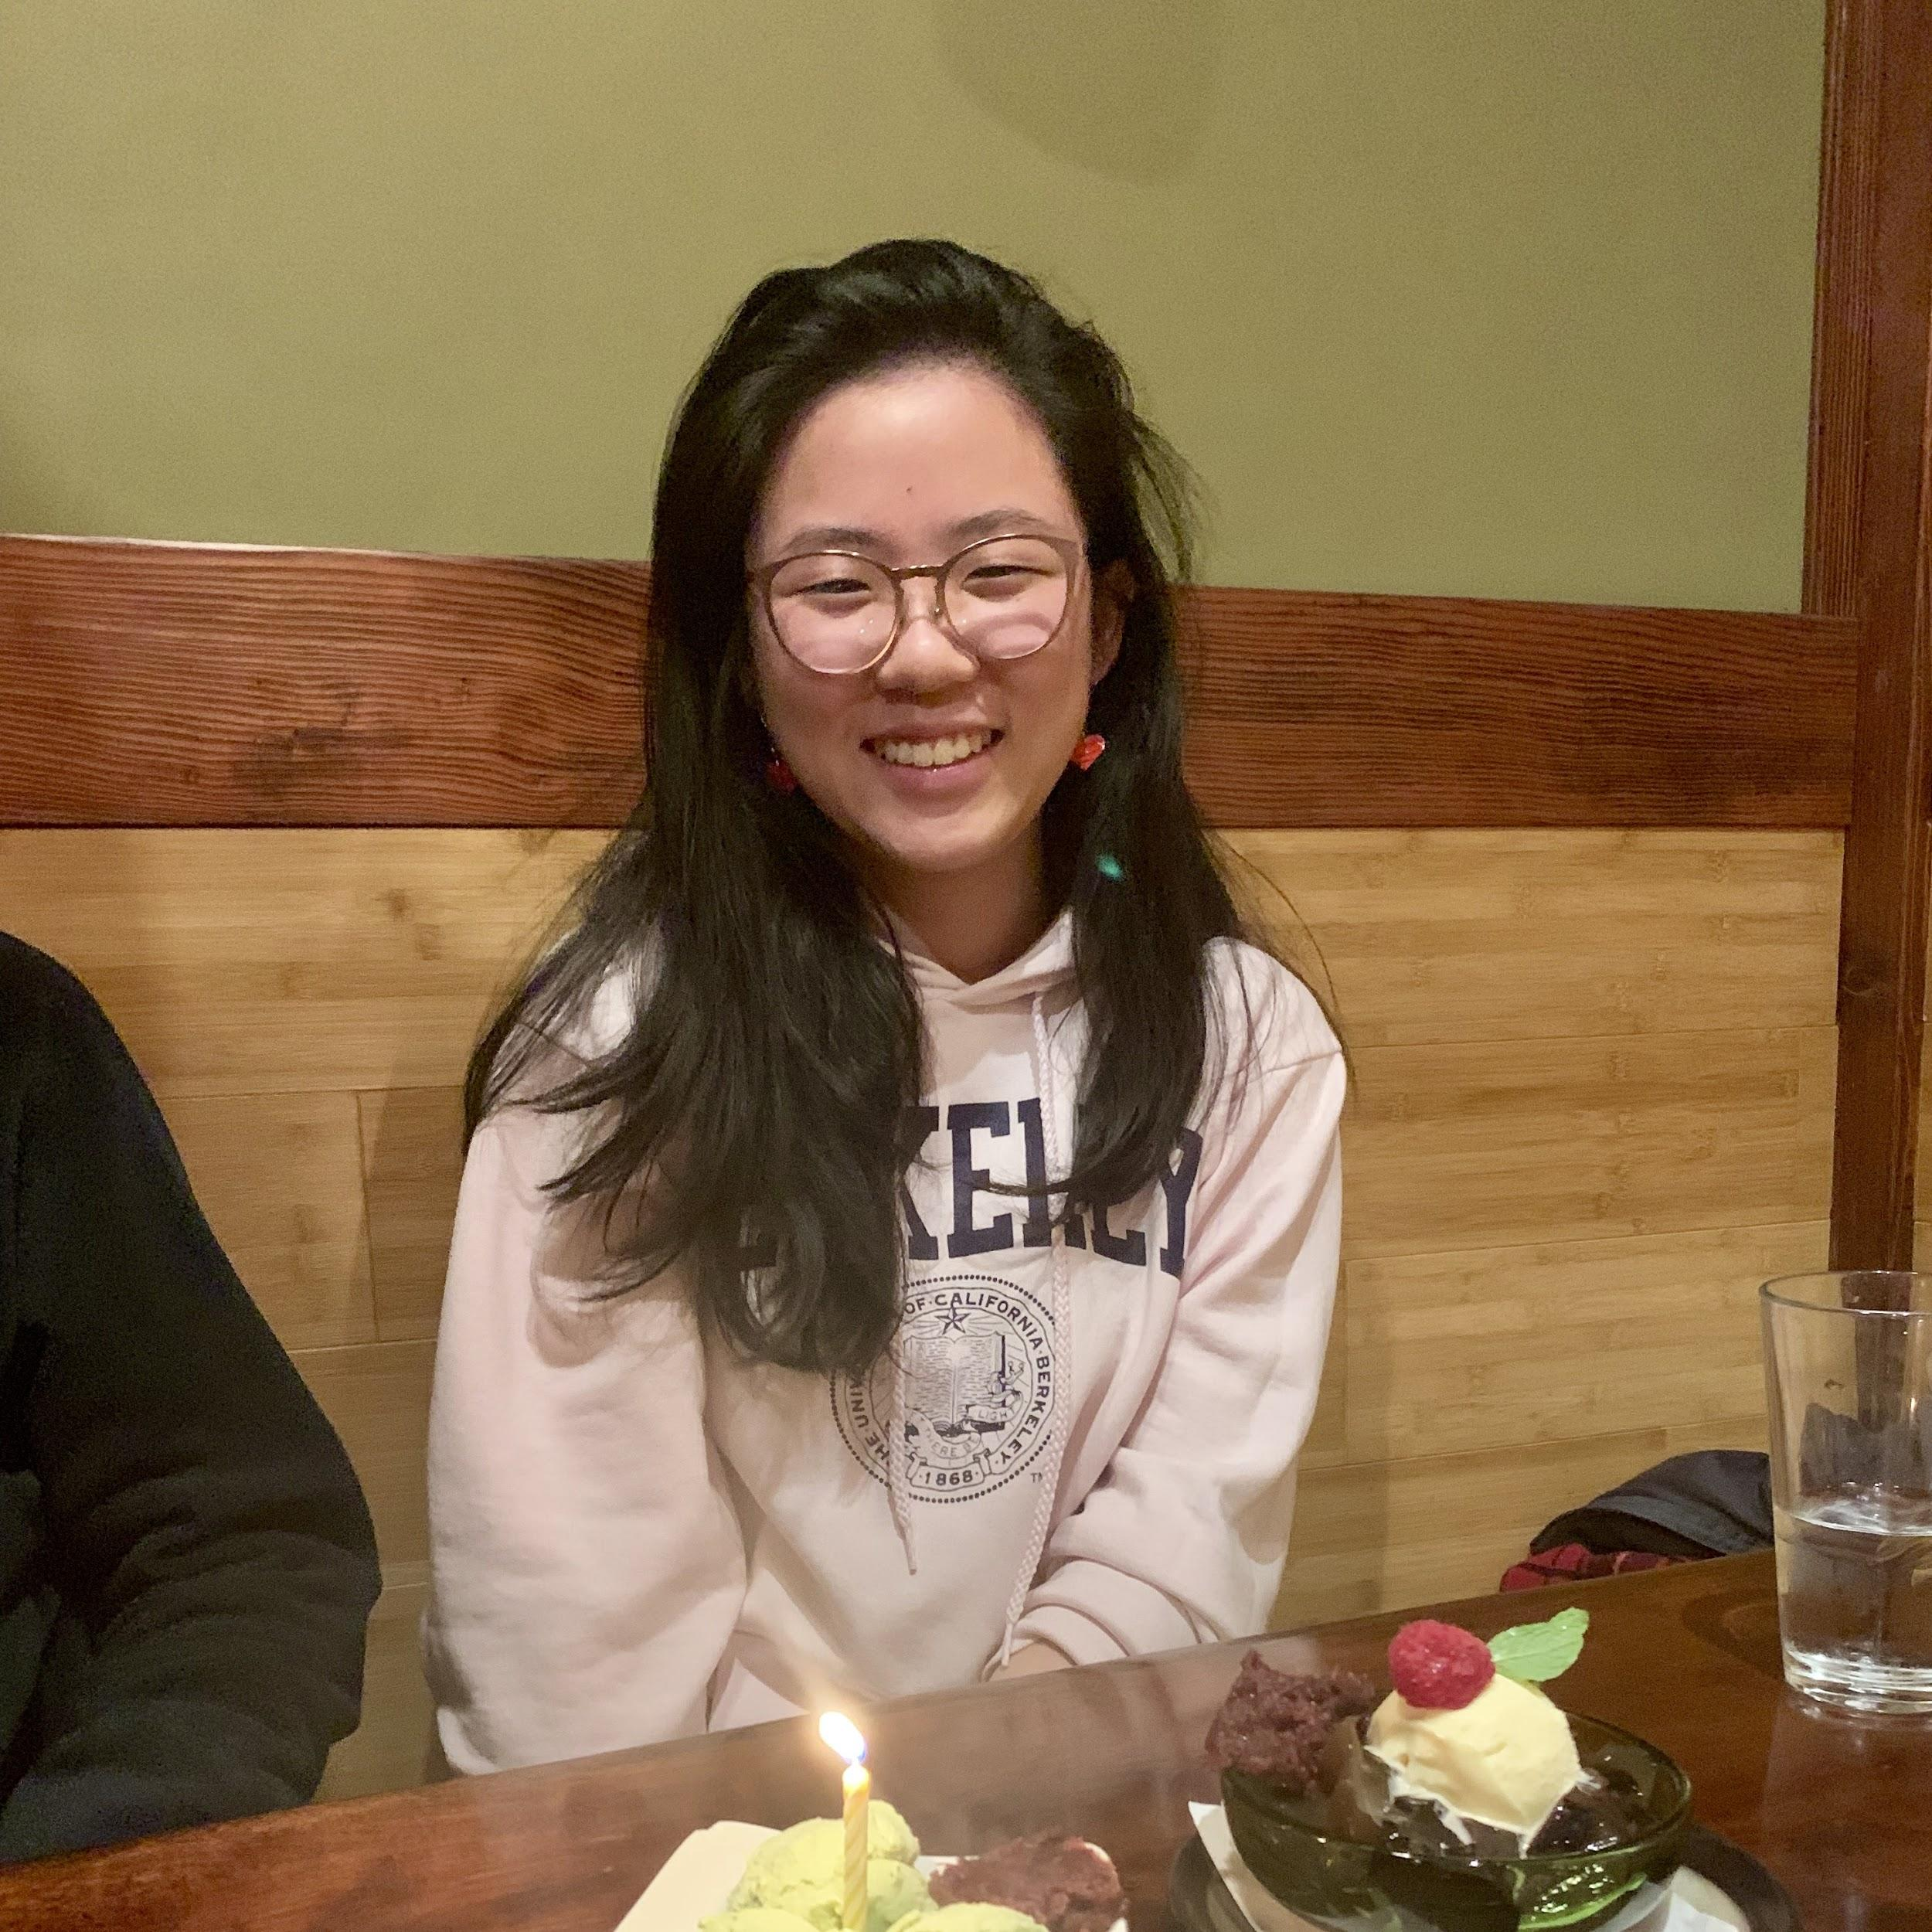


Tutors

Slide 7

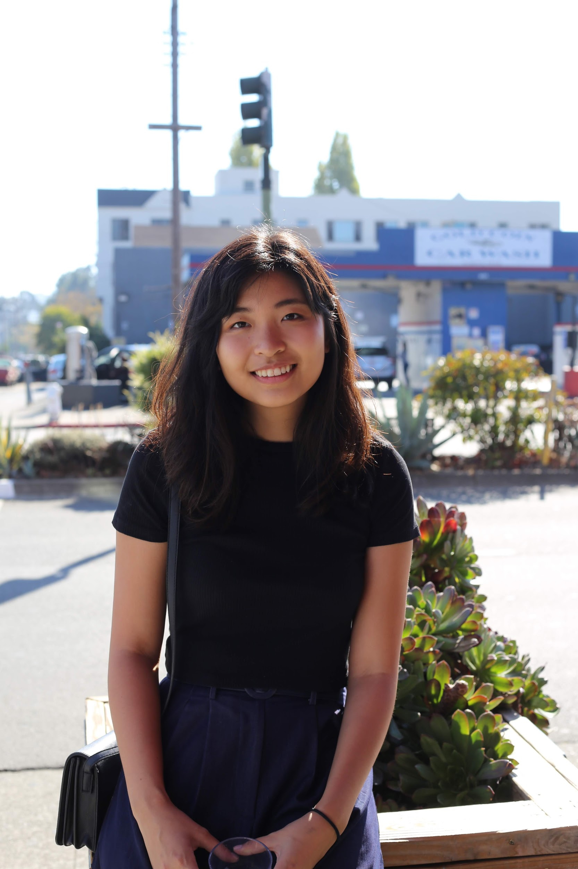


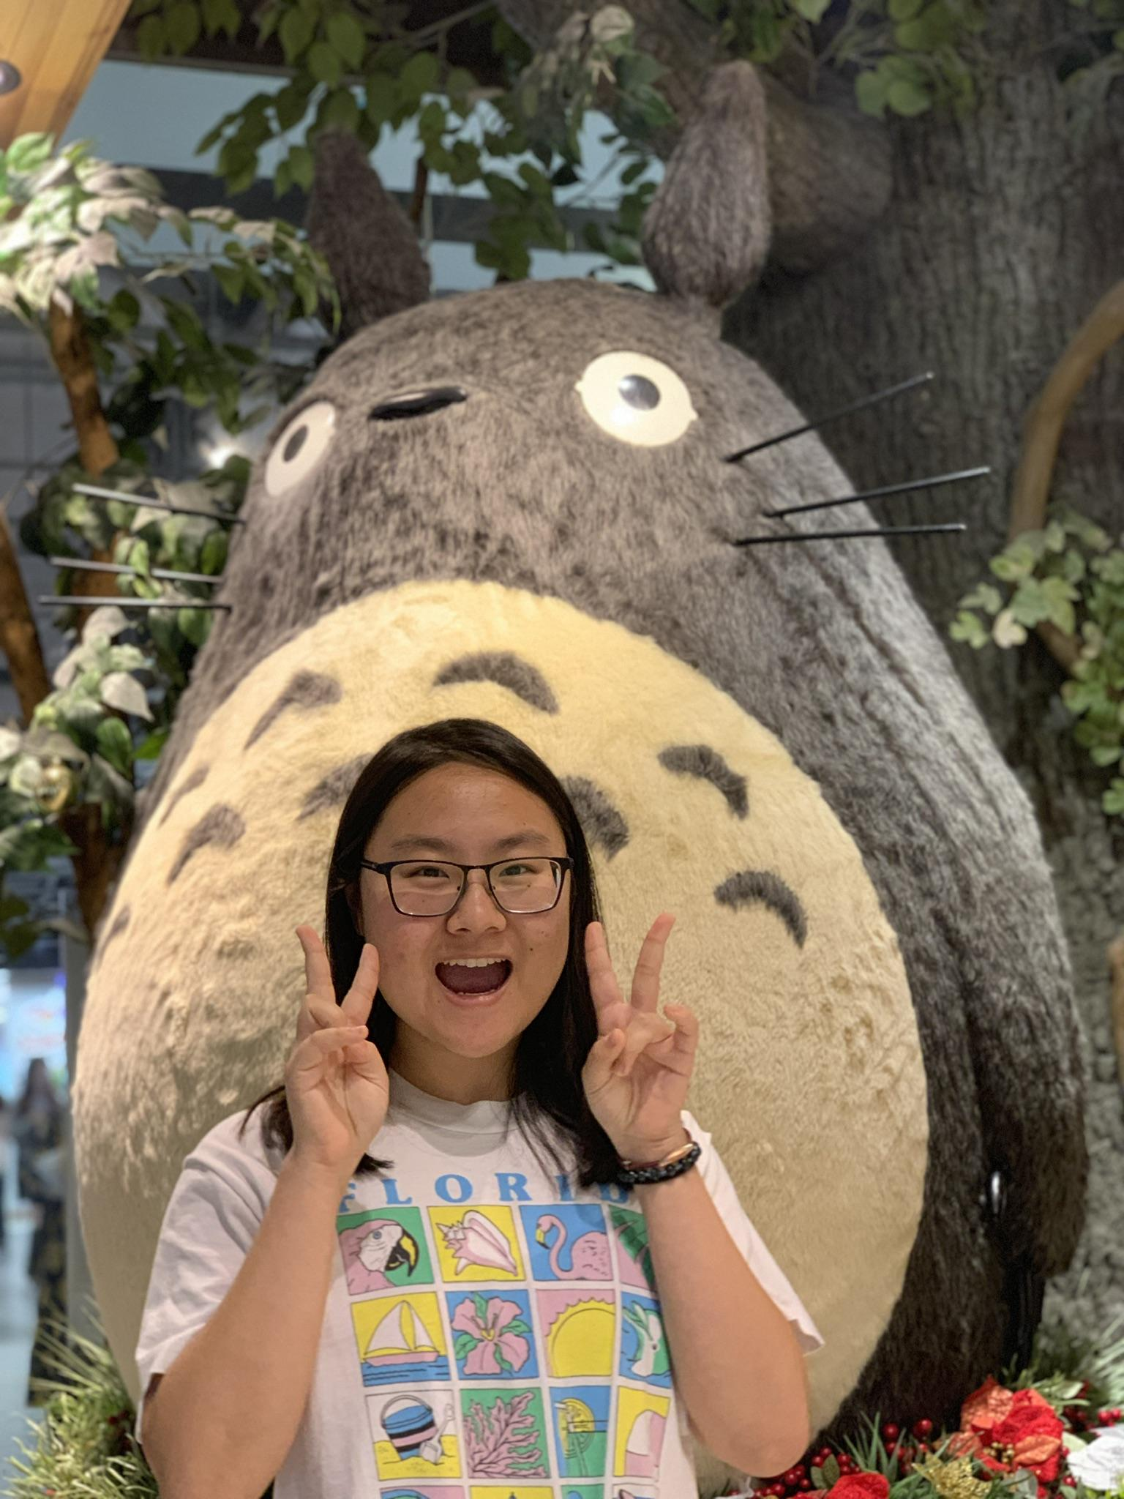
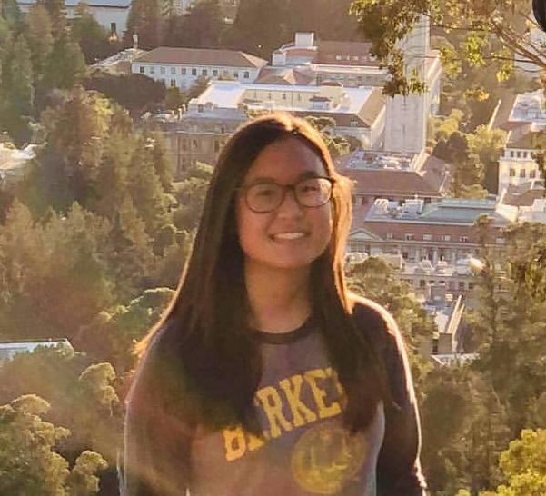
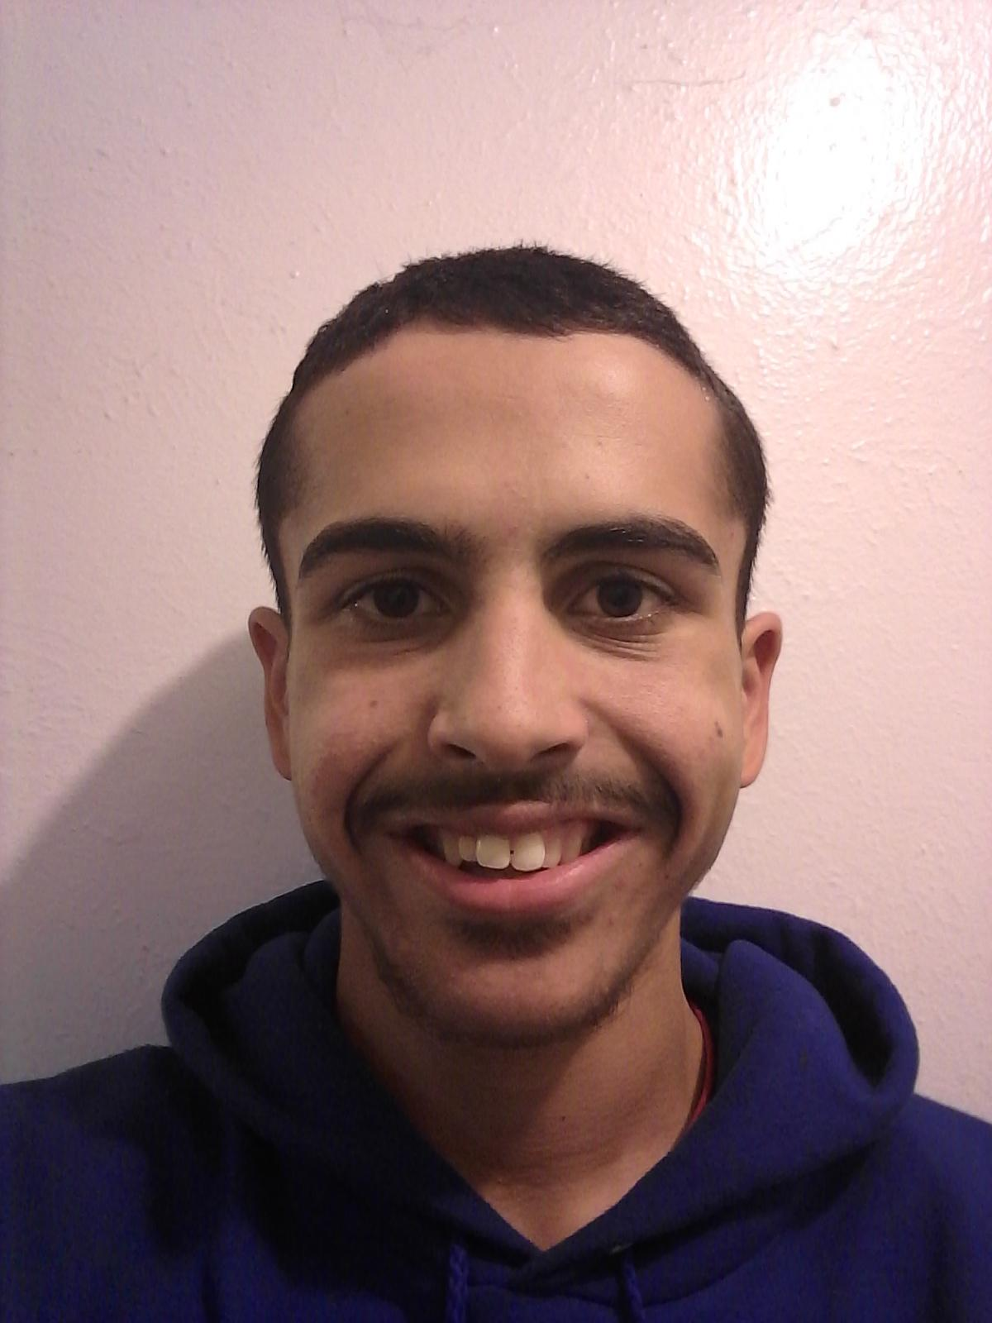
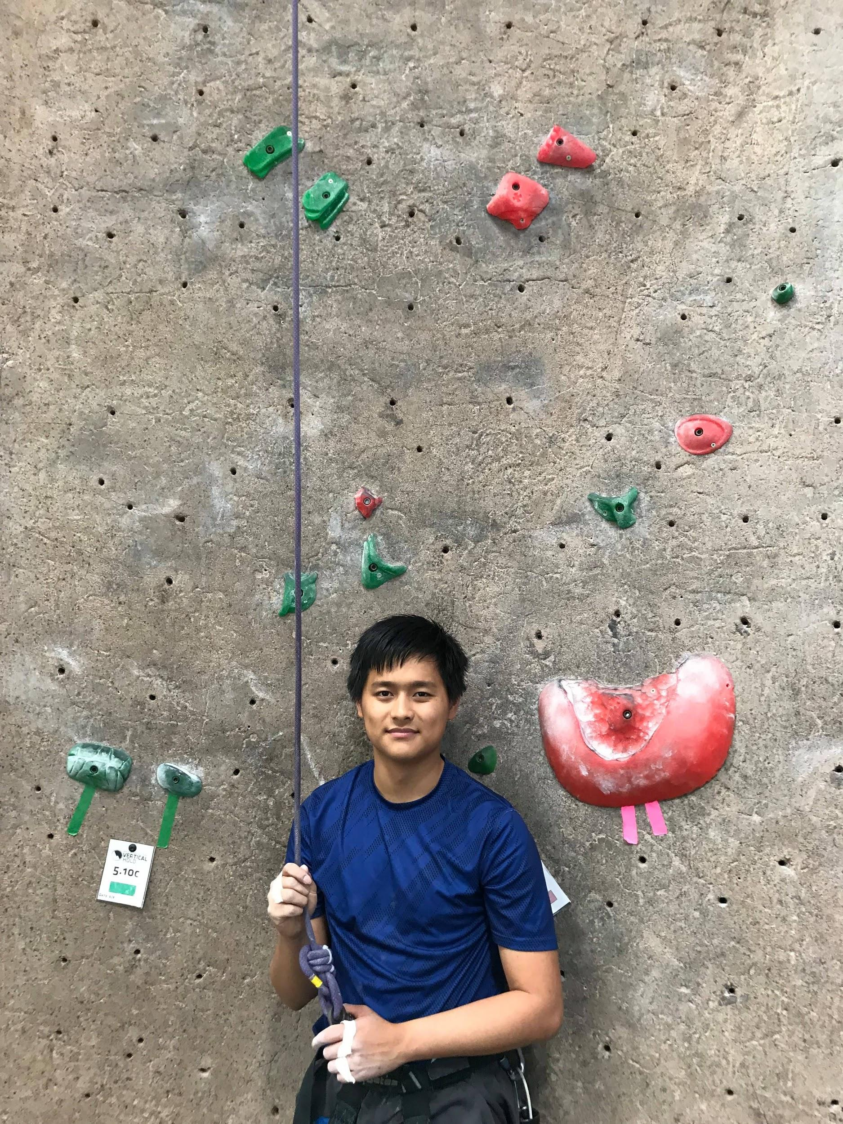
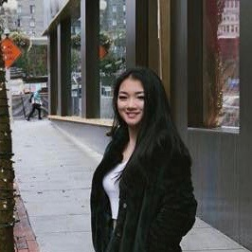

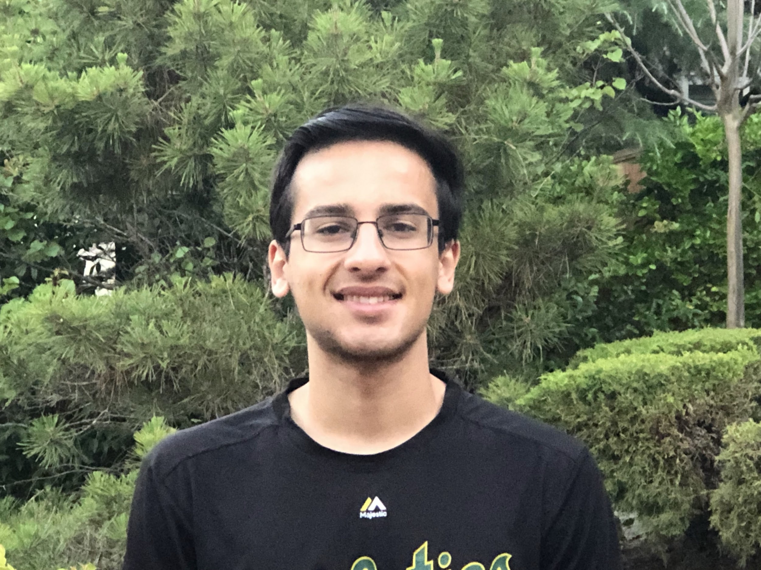

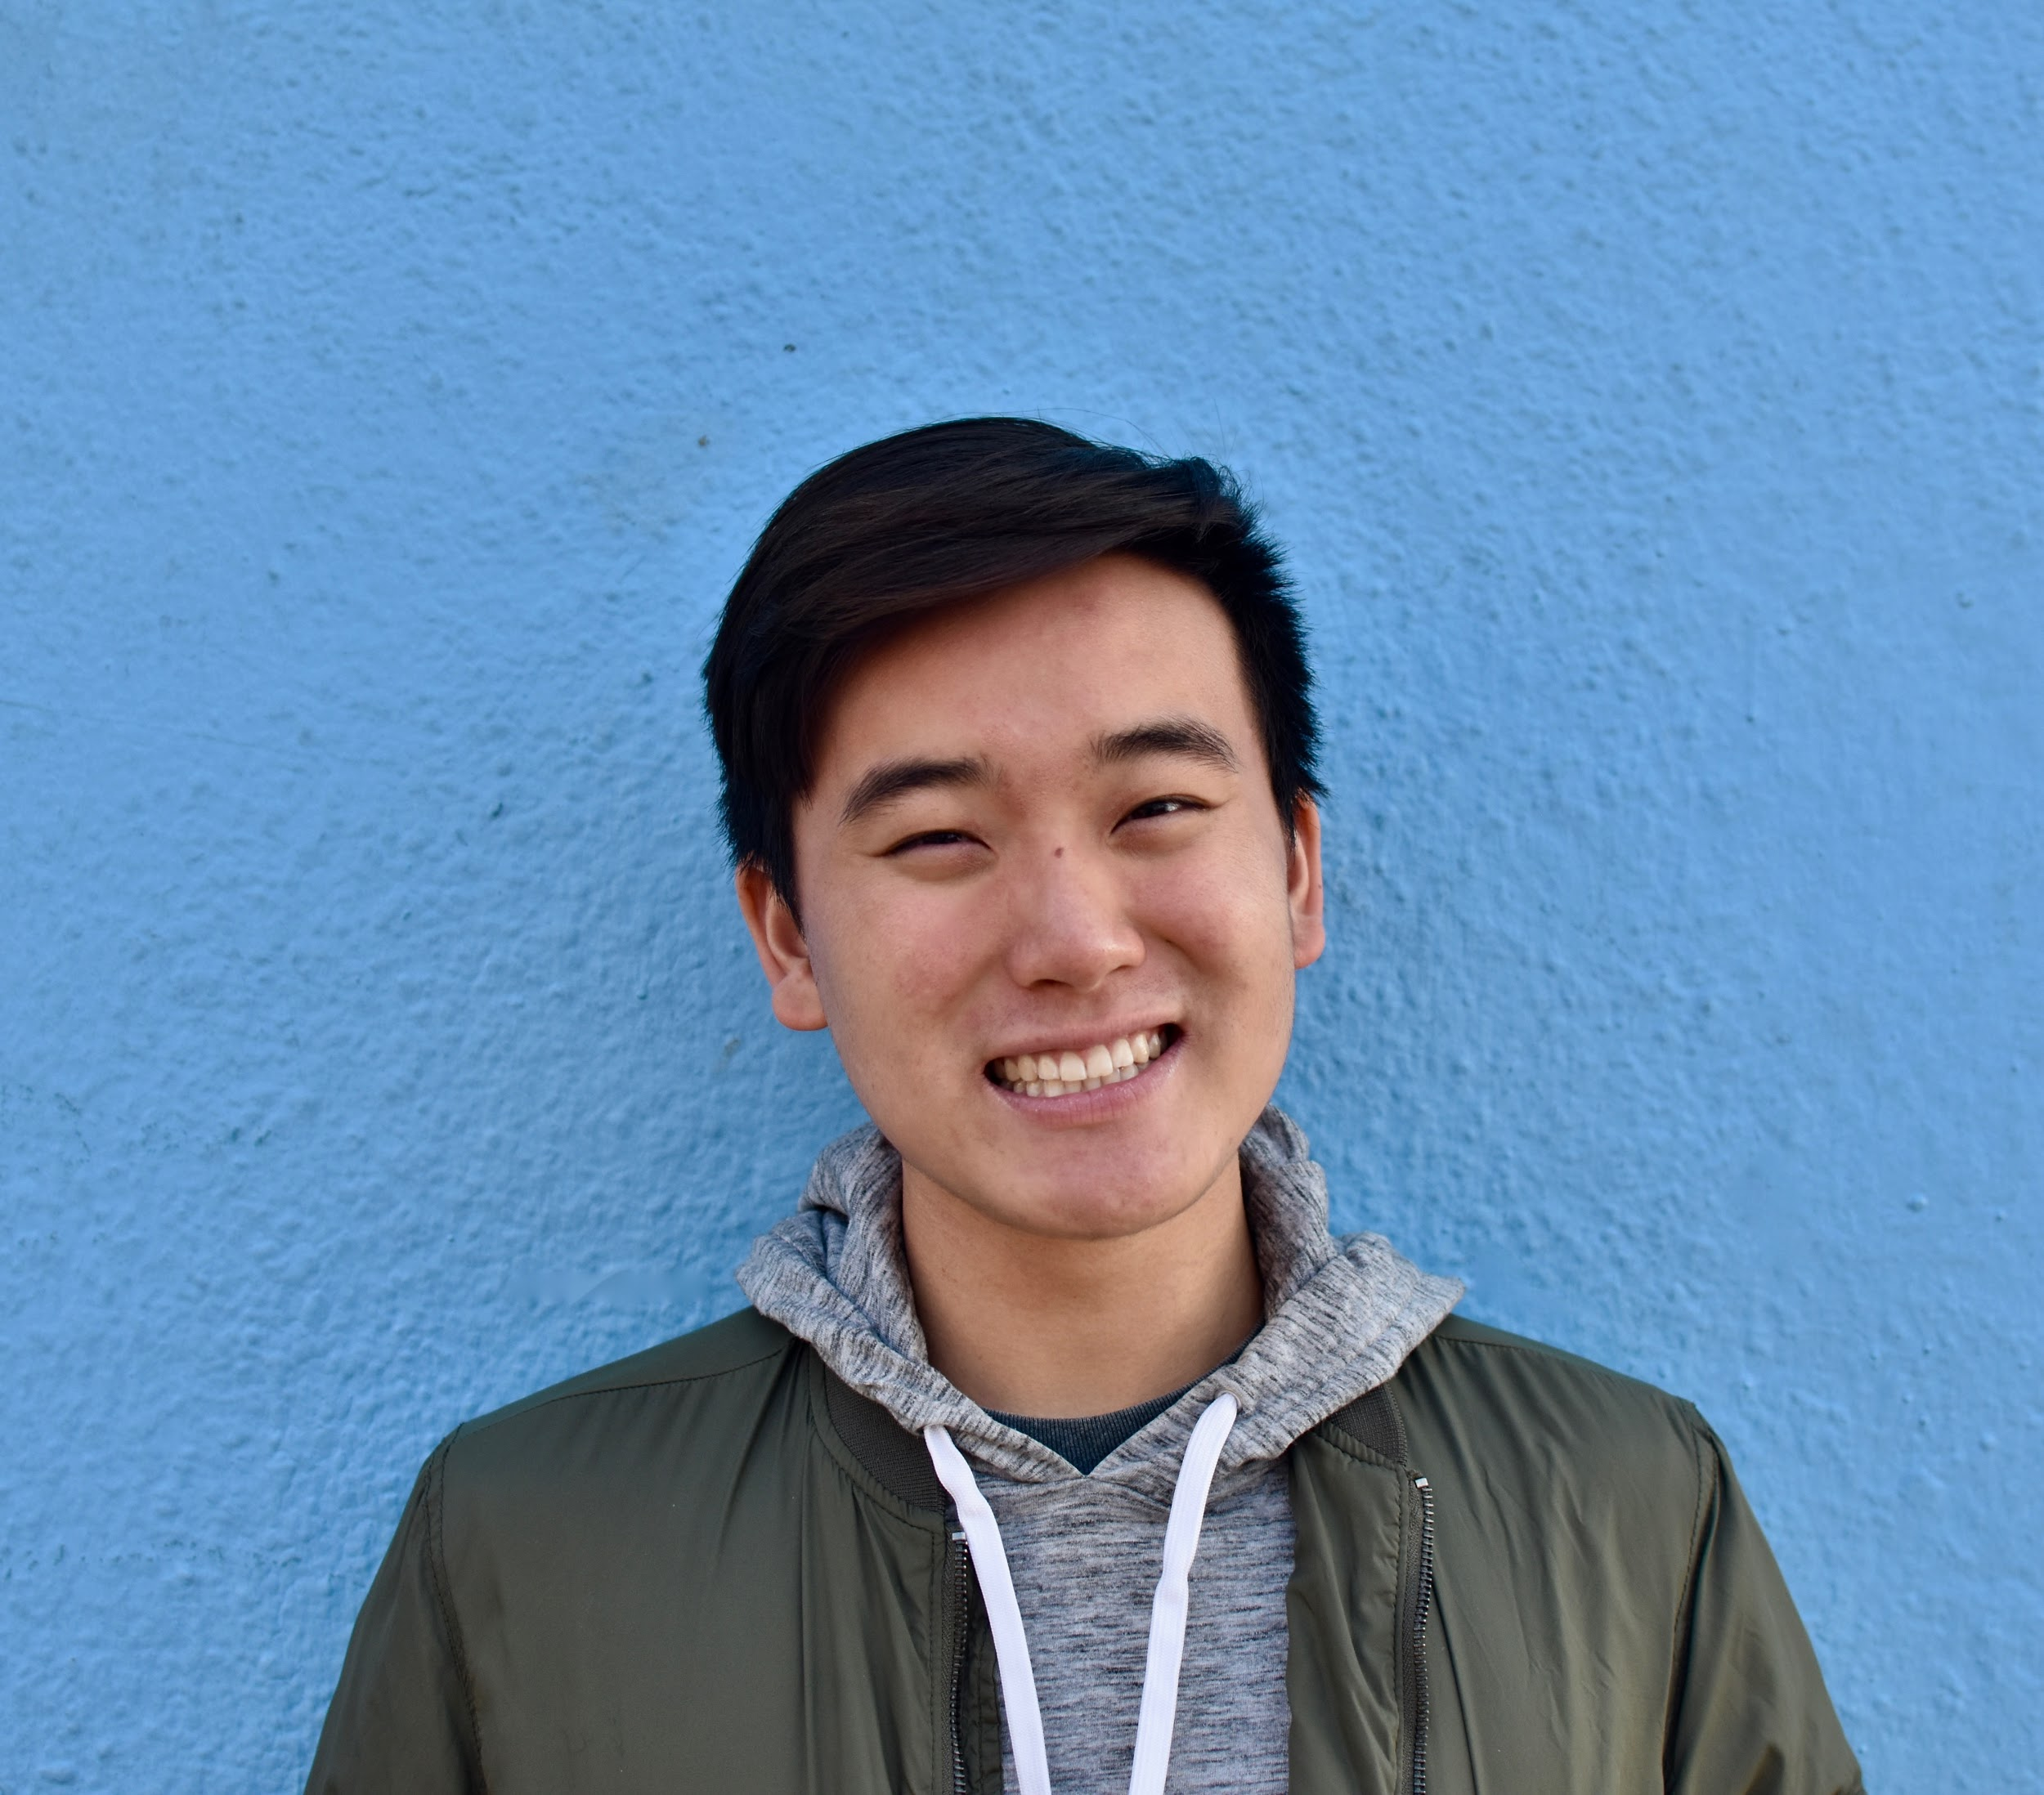
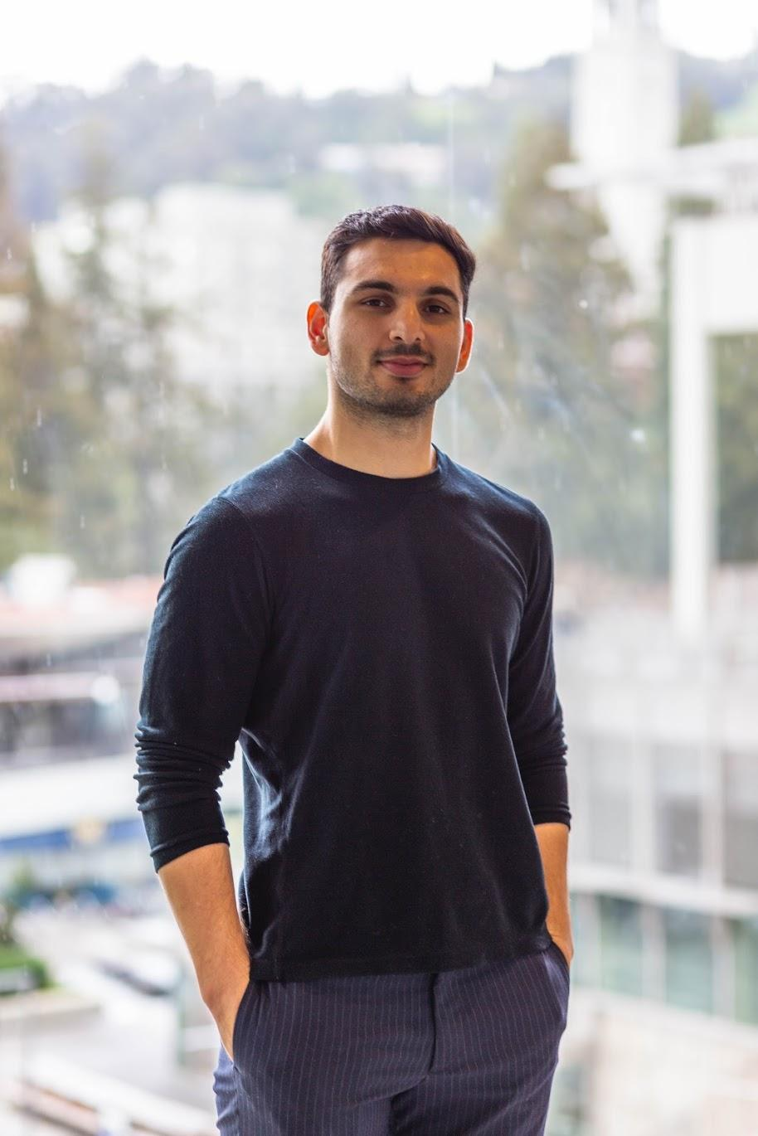
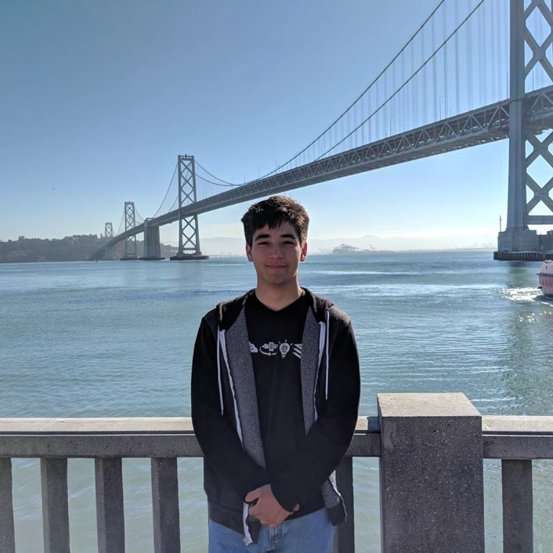

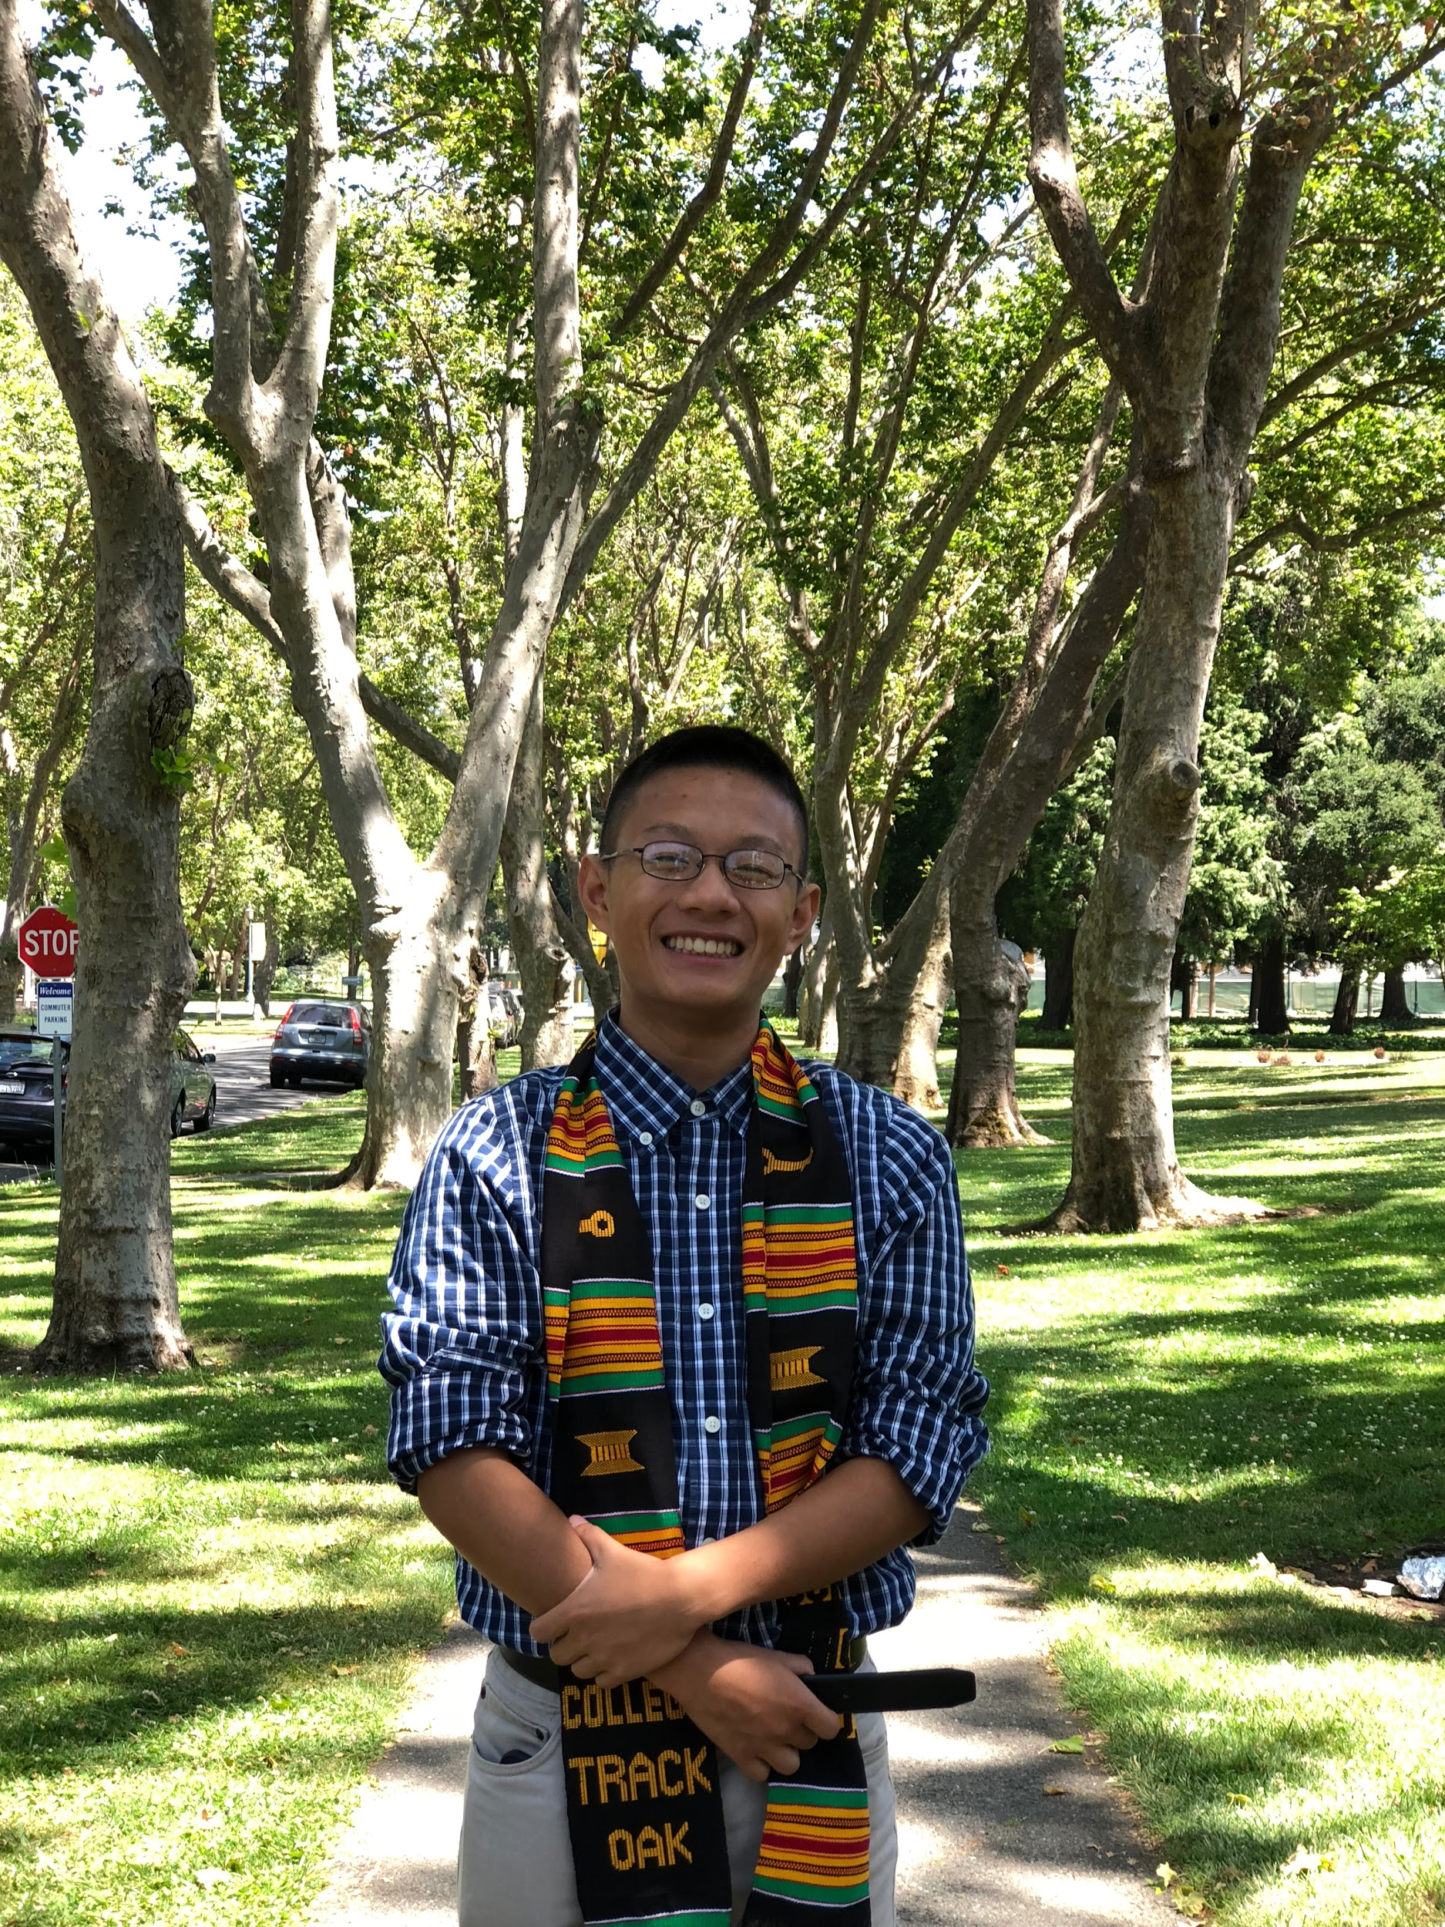
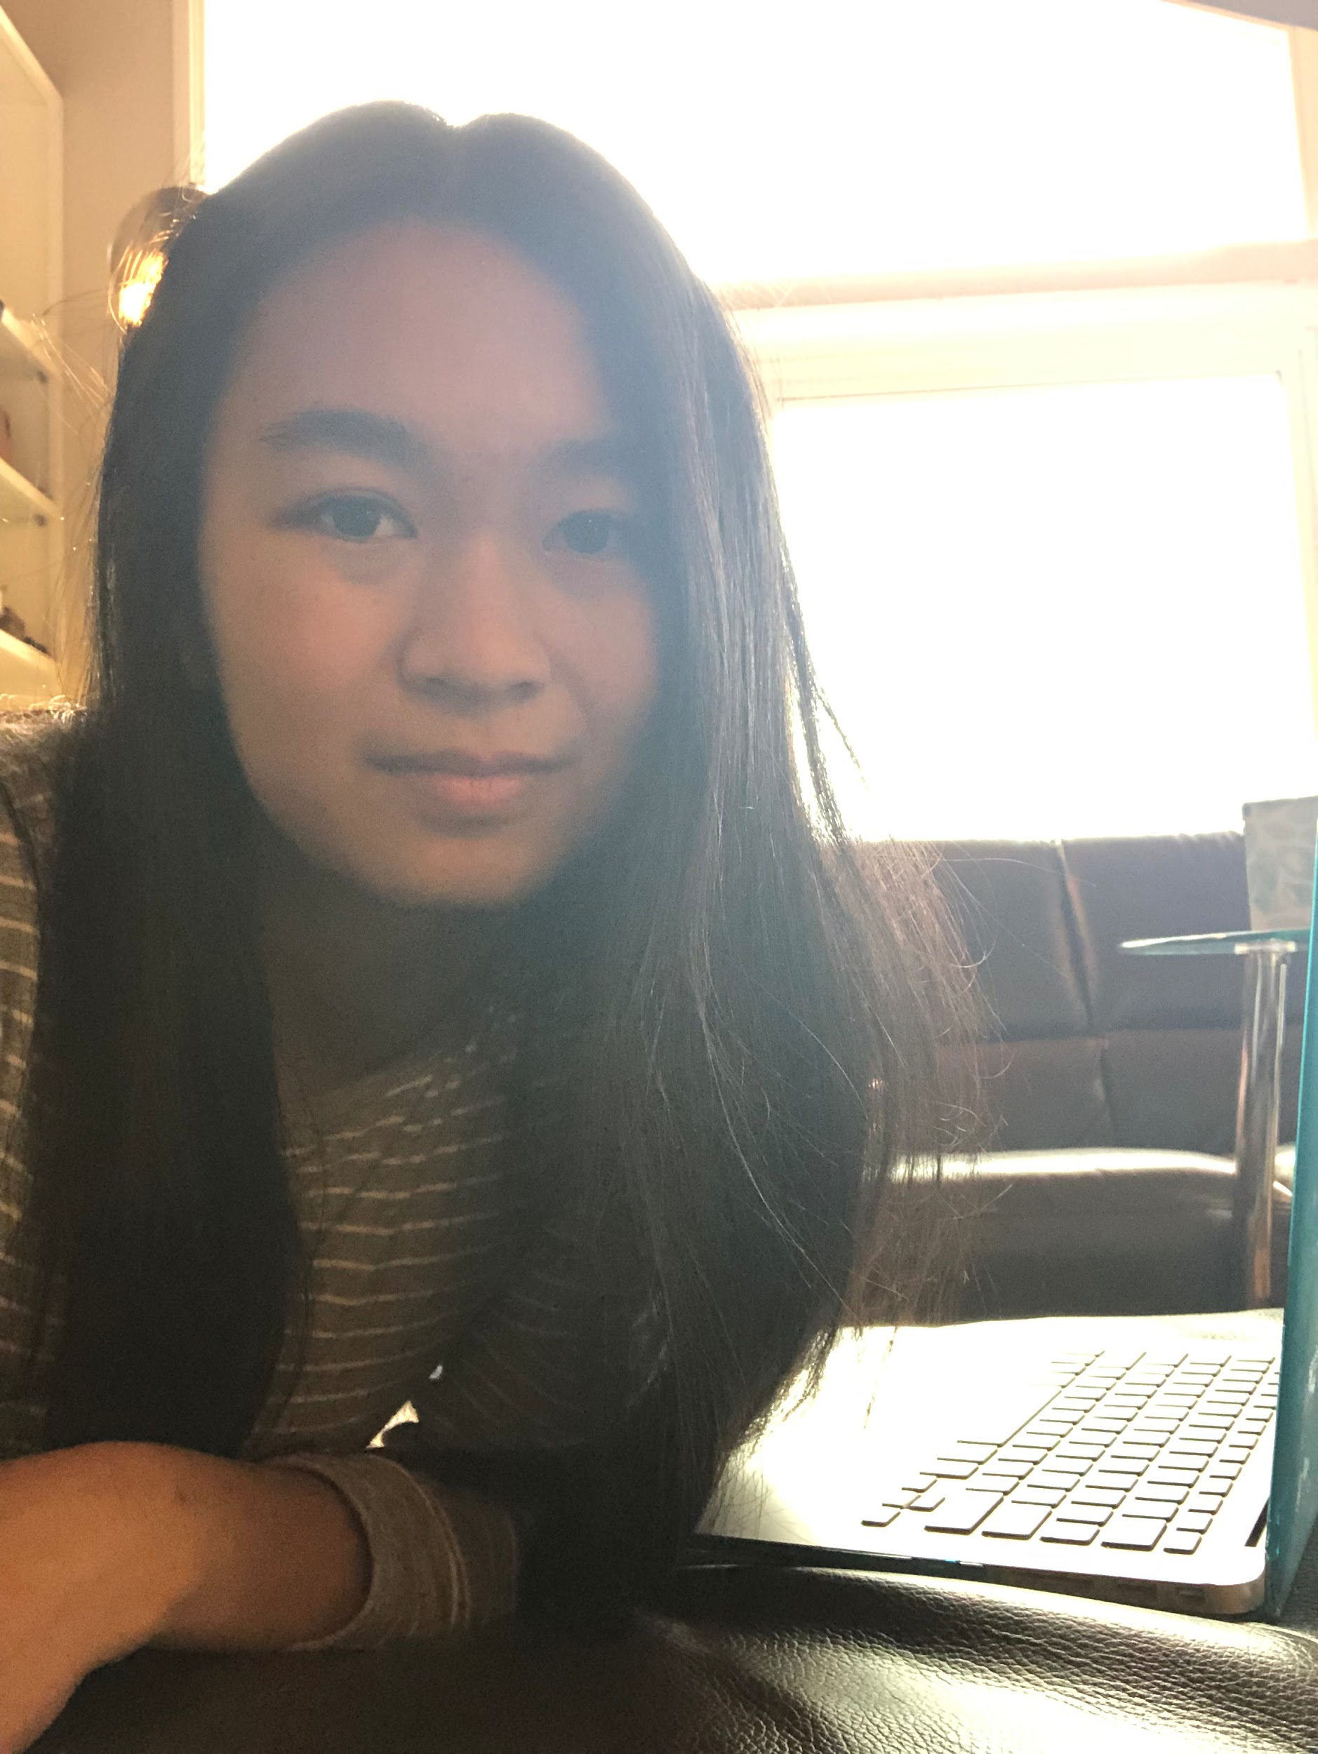
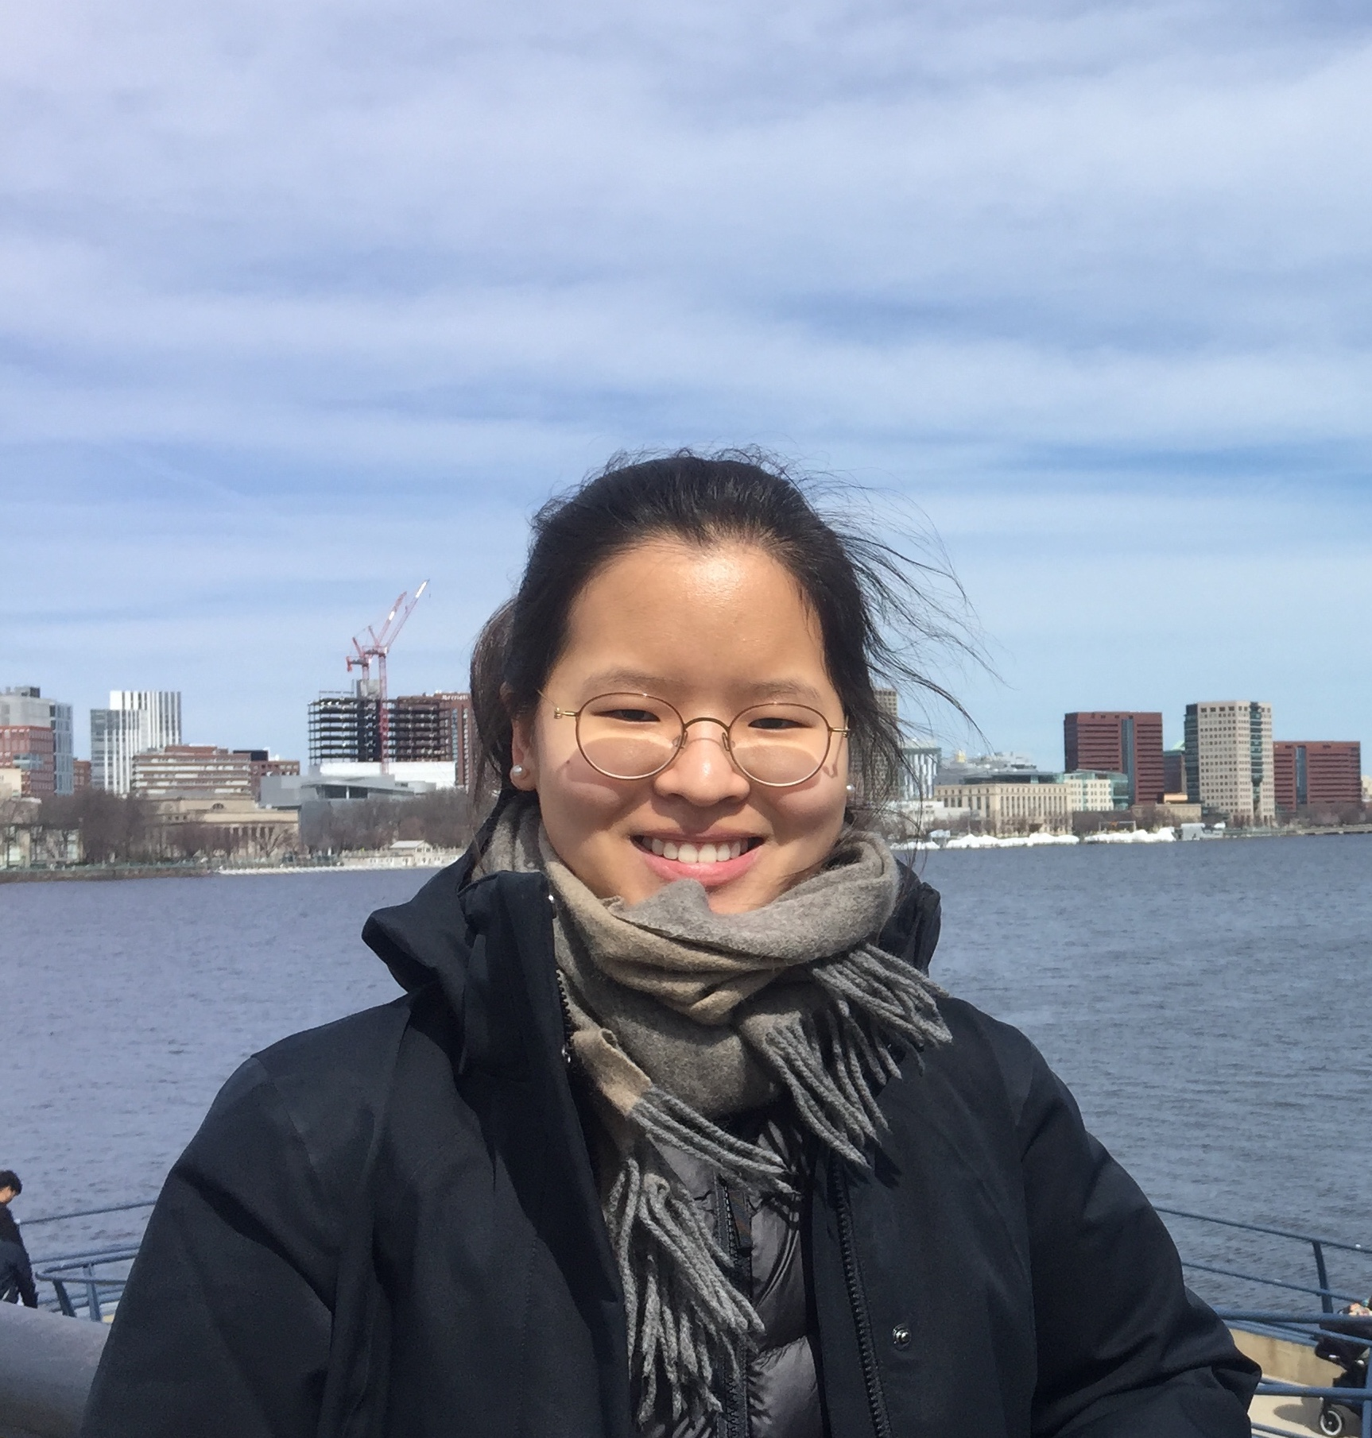
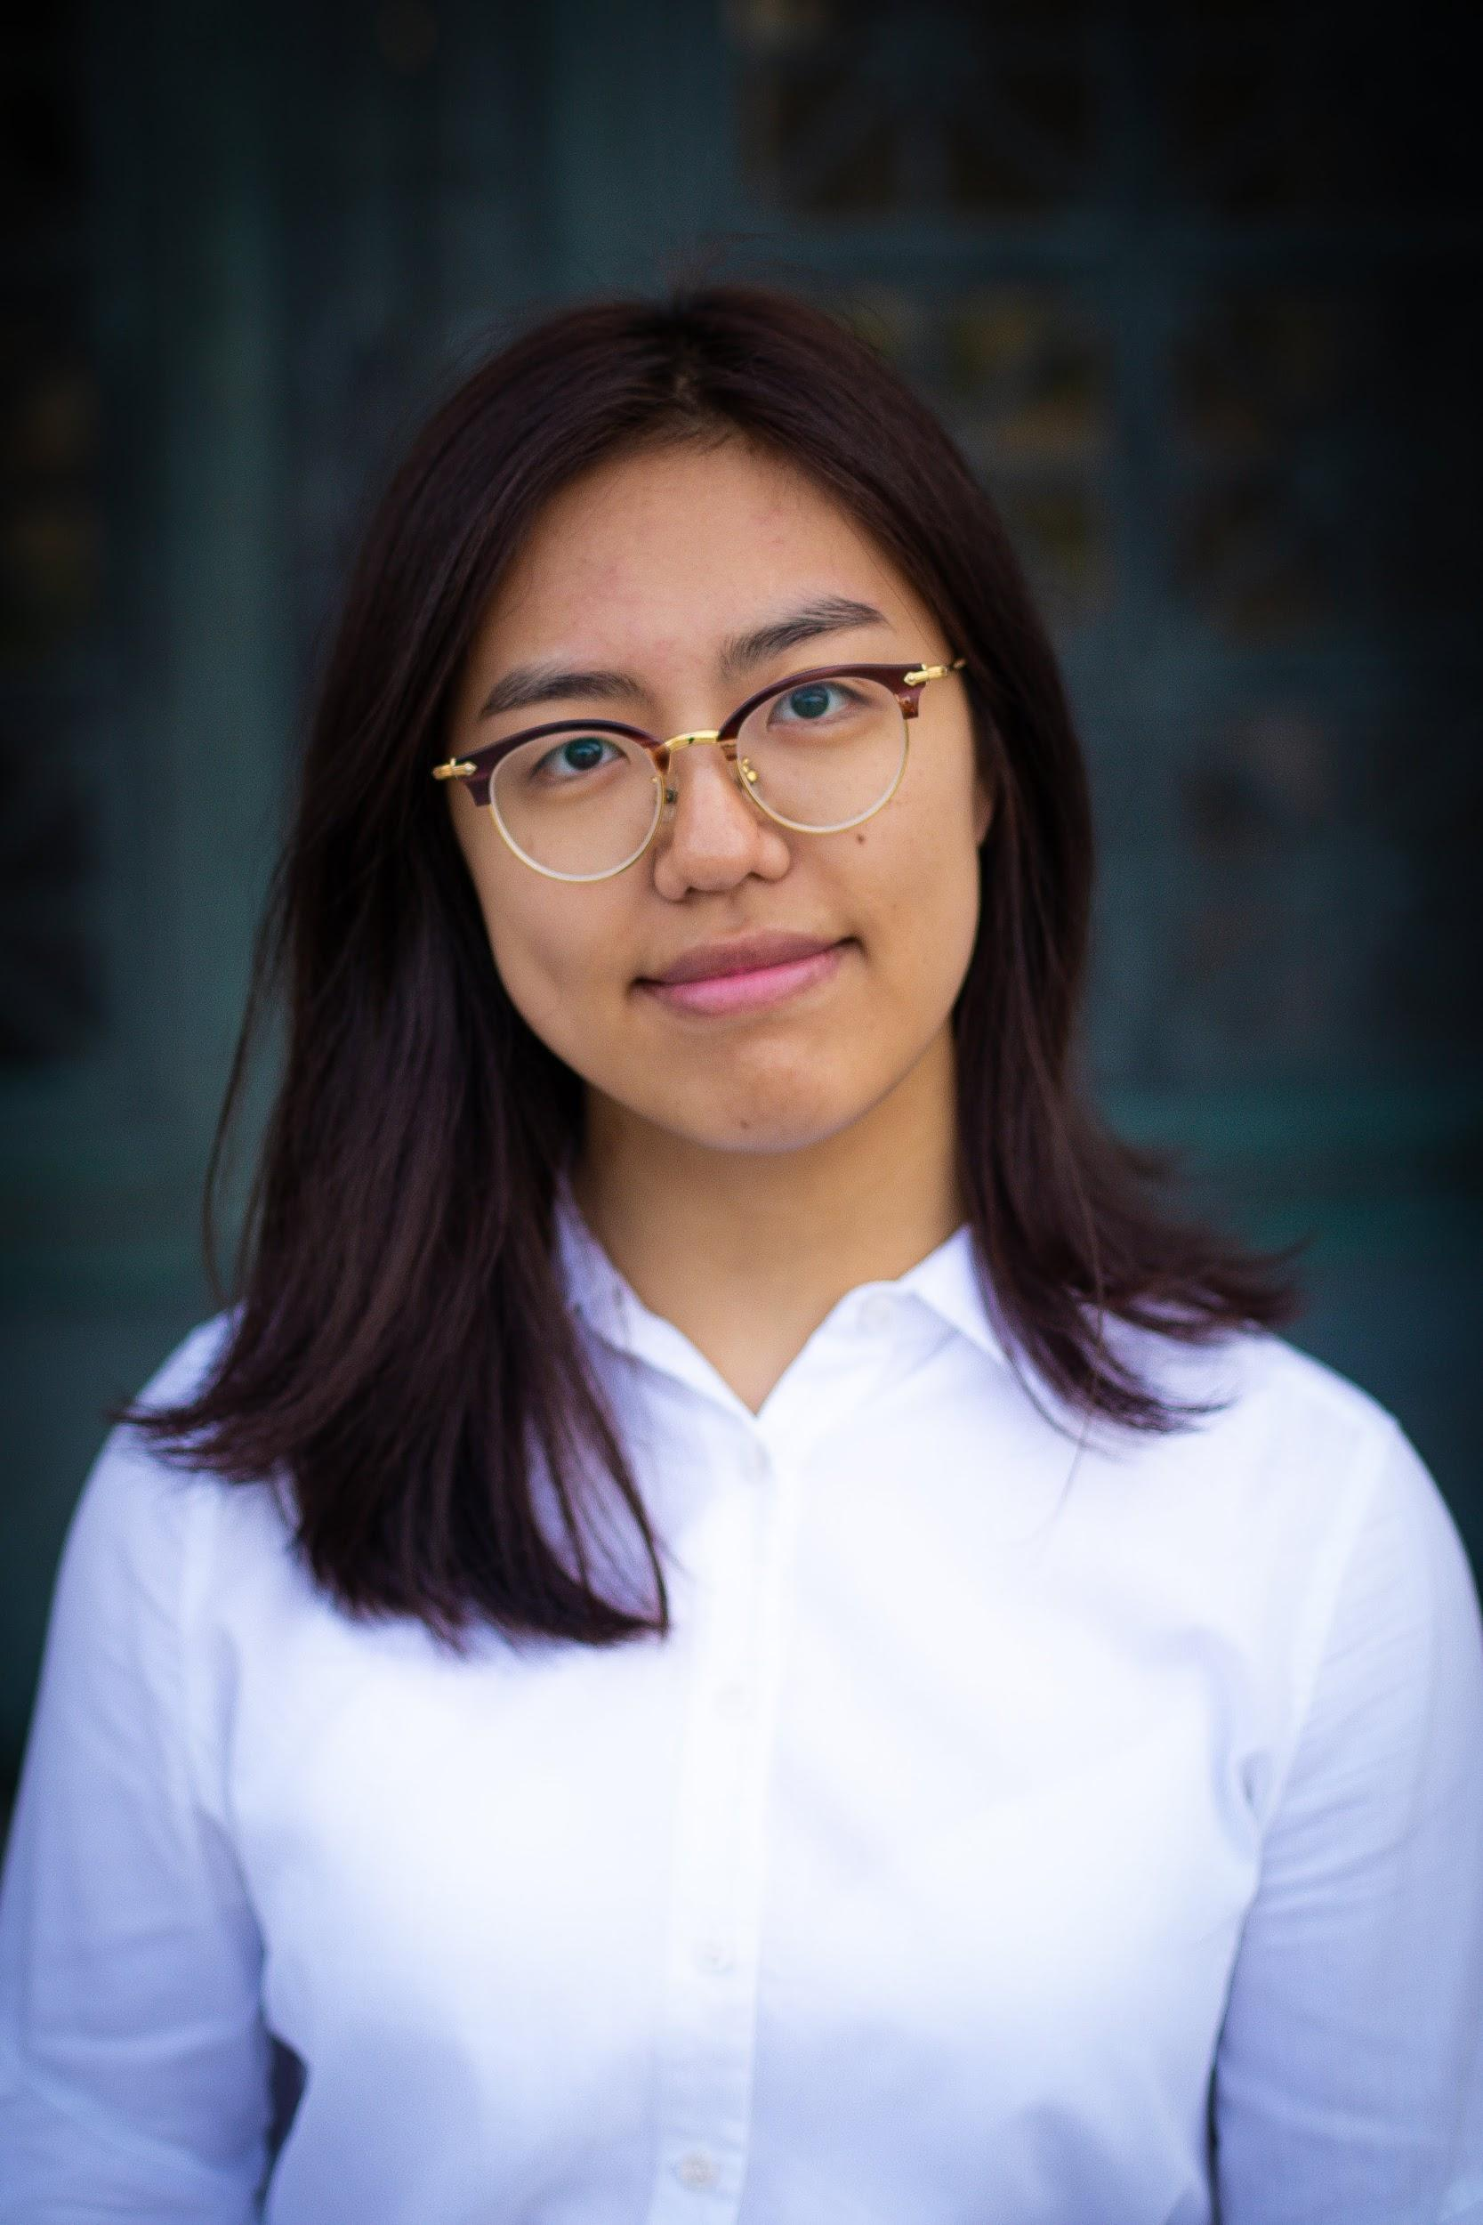
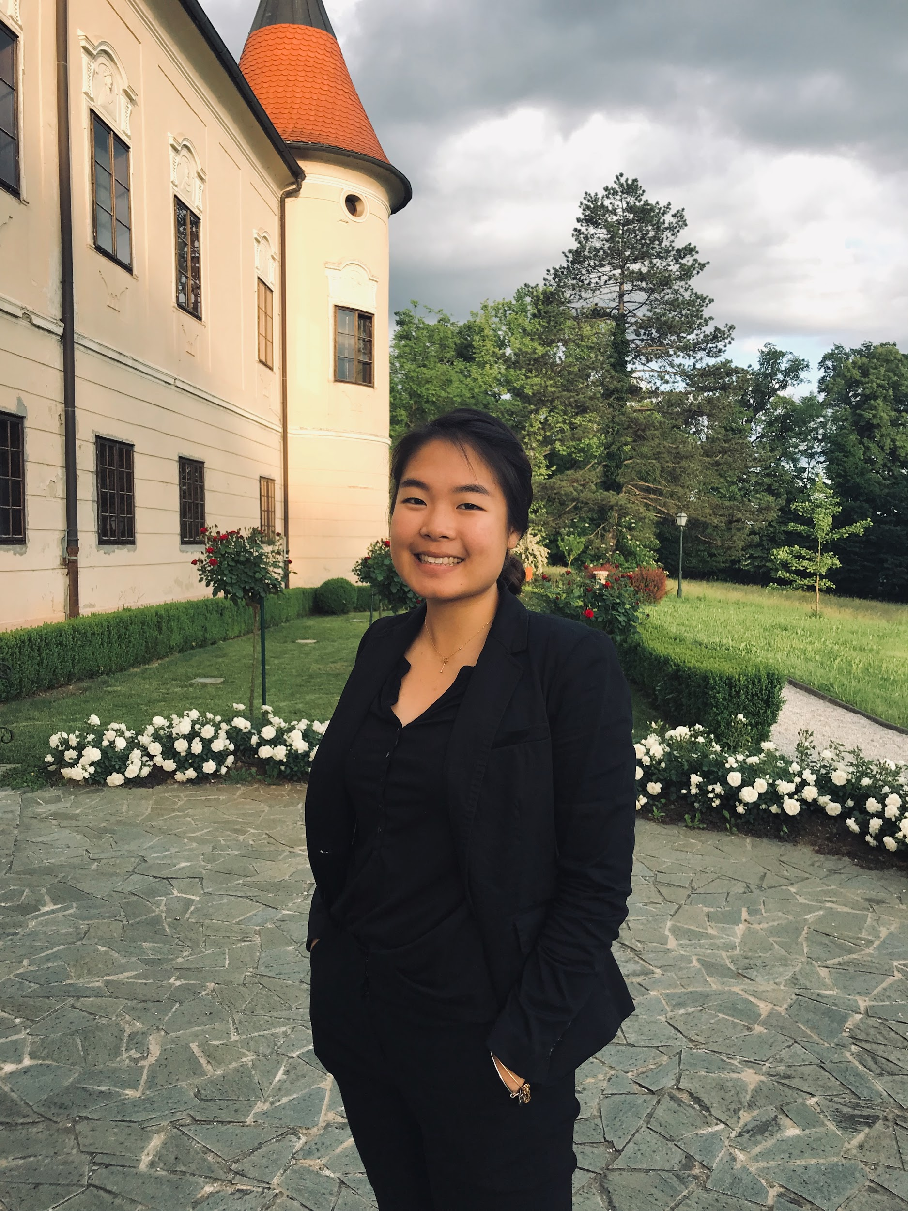
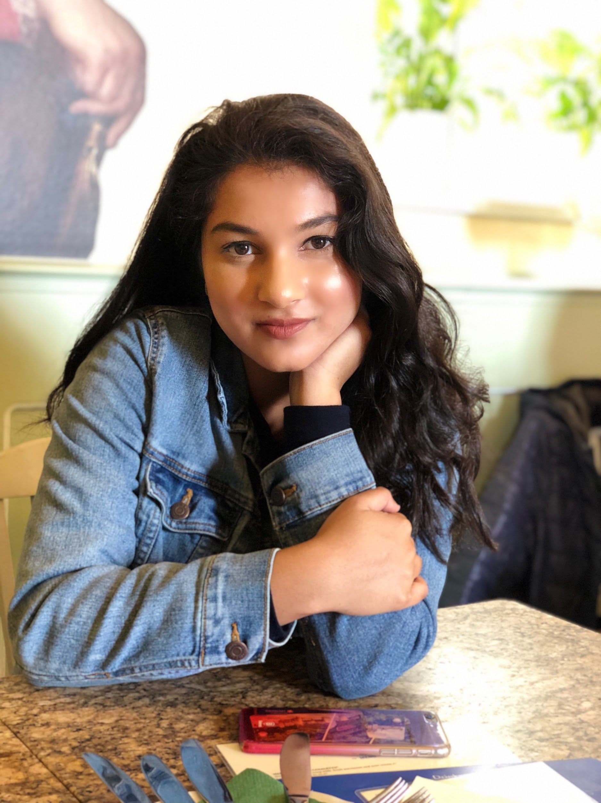


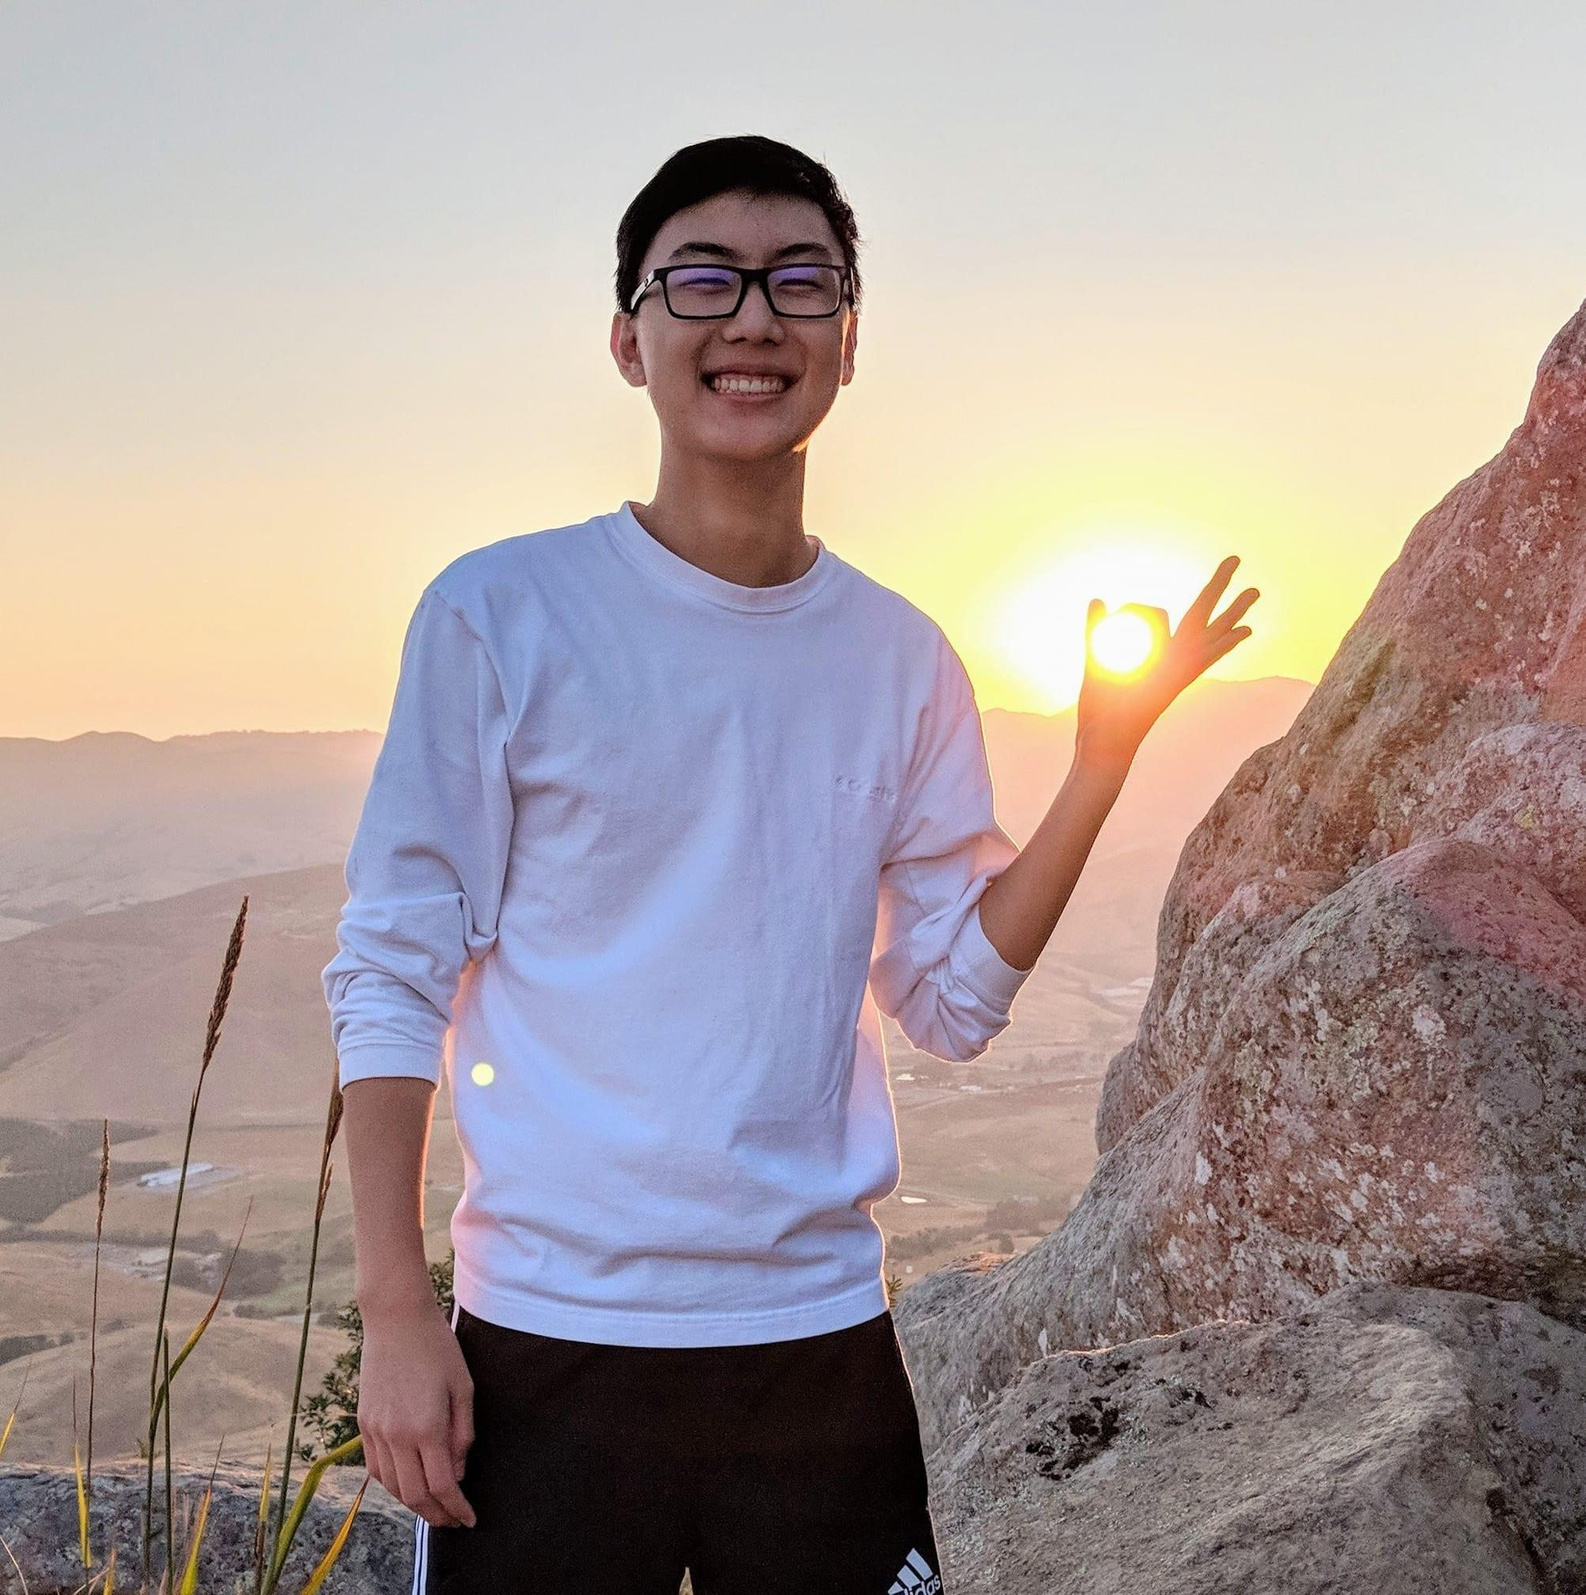


Academic Interns
And many more!

Slide 8
You!

Slide 9
Computer Science

Slide 10
What is Computer Science?
What problems can be solved using computation?
How to solve those problems?
What techniques lead to effective solutions?

Slide 11
What is Computer Science?
Systems
Artificial Intelligence
Graphics
Security
Networking
Programming Languages
Theory
Scientific Computing
...

Slide 12
What is CS 61A about?
Managing Complexity
Mastering Abstraction
Programming Paradigms
Introduction to Programming
Full understanding of Python fundamentals
Combining multiple ideas in large projects
How computers interpret programming languages
A challenging course that will demand a lot from you

Slide 13
Alternatives to CS 61A

Slide 14
CS 10: The Beauty and Joy of Computing
Designed for students without prior experience
An introduction to fundamentals (& Python) that sets students up for success in CS 61A
2 person waitlist
Summer 2019: Matthew Schwartz & Mansi Shah
More info: cs10.org

Slide 15
Data 8: The Foundations of Data Science
Fundamentals of computing, statistical inference, & machine learning applied to real-world data sets
More statistics than computer science
Great programming practice for CS 61A
Listed as CS C8
30 person waitlist
Summer 2019: Natalia Mushegian & Francie McQuarrie
More info: data8.org

Slide 16
Course Logistics

Slide 17
Course Format
Lecture
MTuWTh 11-12:30 in 155 Dwinelle
Lab Section
The most important part of this course
Discussion Section
The most important part of this course
Staff Office Hours
The most important part of this course
Online textbook
https://composingprograms.com
Weekly homework assignments
Four programming projects
A midterm and a final
Lots of course support

Slide 18
The First Week
Lab starts Wednesday
Discussion starts Tuesday
Please try to attend the lab section that matches with your discussion number. See the welcome post on piazza/the policies page.
OH start Tuesday

Slide 19
Missing Sections
Lecture attendance not tracked
Lecture videos will be released but shouldn’t be considered a replacement for lecture unless you cannot attend
Discussion/Lab attendance tracked
Can miss a couple of sections with absolutely no penalty
See participation policy (in a few slides!)
All assignments (including lab) can be submitted remotely

Slide 20
Small Group Tutoring Sections
Small-group sections (4-5 students) centered around a worksheet which reviews content from the corresponding discussion
These are optional and we will have a sign up end of week

Slide 21
Conceptual OH
Some office hours are marked as “Conceptual” office hours
At these OH, you cannot ask questions about assignments, but can come with questions about the concepts presented in lecture/lab/discussion
There will also be opportunities to get extra practice with the material!

Slide 22
Guerrilla Sections
Guerrilla Sections will have you working through a worksheet in groups of about 4 students.
The problems progress in difficulty and there will be checkoff questions to ensure everyone in the group understands the material.
If you feel shaky with the material and want to build up to more challenging exam-level questions, or want to find a group to work with, Guerrilla Sections are a great way to make that happen!

Slide 23
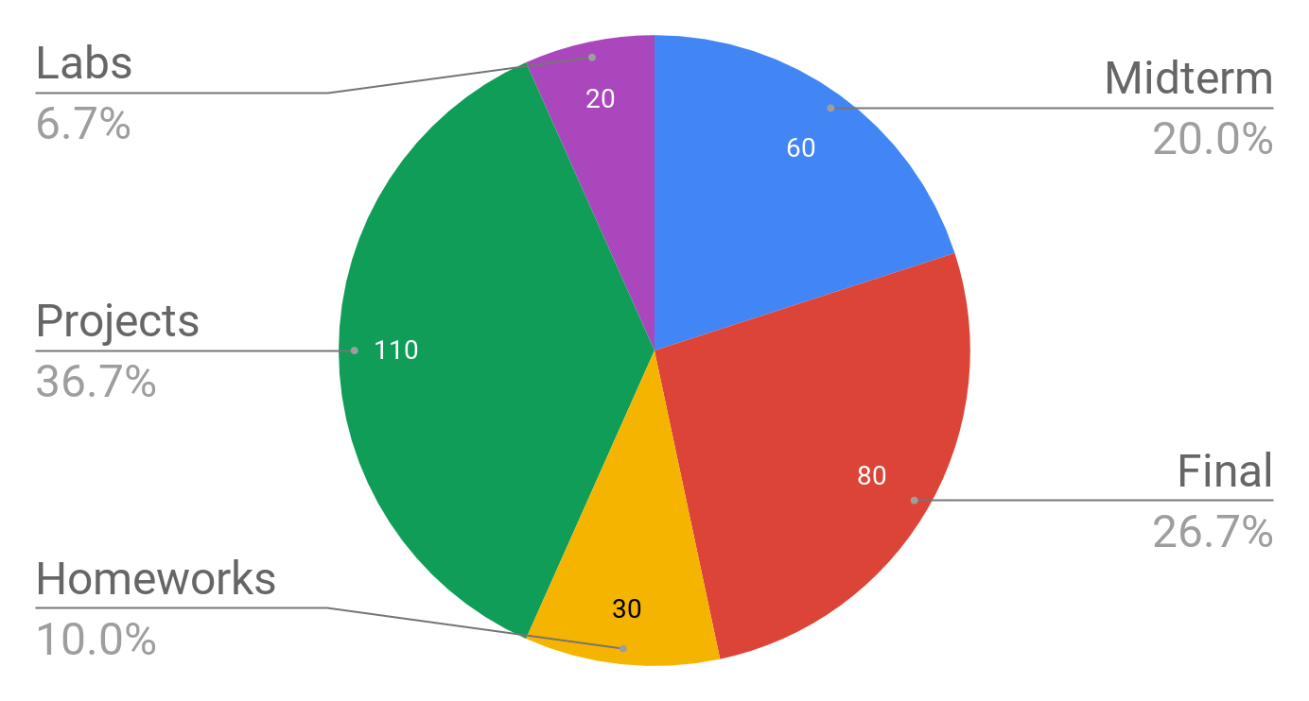
Grading

Slide 24
Participation
Attending lab and discussion count for participation credits
These aren’t used for points; instead, they are used to calculate exam recovery
Exam recovery applies if you score below 50% on the midterm or final
More details: cs61a.org/articles/about.html#lab-and-discussion-participation

Slide 25
Homeworks
Will be graded on “effort”
This approximately means, completing most of the problems and at least attempting to solve the rest
This means there’s no reason to cheat!
Ask for help if you are stuck and make a good effort on all of the homework
More details: cs61a.org/articles/about.html#homework

Slide 26
Projects
Will be graded on correctness and composition
Several of the programming projects will be partnered
Larger than homeworks
More details: cs61a.org/articles/about.html#projects

Slide 27
Labs
Graded on correct completion
Lowest two lab grades dropped
Not required to be completed at your lab section; however, students have found working in lab is more helpful than doing so independently
More details: cs61a.org/articles/about.html#labs

Slide 28
Slip Day
Everyone gets one slip day for the summer which can be applied to homeworks or projects
If your project partner has a slip day but you already used your slip day and you both submit your project a day late, you will receive a late penalty and your project partner will not.
When used, extends the final deadline for the assignment by 24 hours
More details: cs61a.org/articles/about.html#slip-day

Slide 29
Exams
Midterm Exam
Thursday, July 18th
3 hour exam
Alternates only for direct conflict with another course
Final Exam
Thursday, August 15th
3 hour exam
Alternates in case of direct conflict with another course
More details soon

Slide 30
Preparing for Exams
Exam questions are different than homework/lab/discussion questions
The only way to really prepare for exams is to do past exams
See https://cs61a.org/resources.html for past exams, including past exam problems by topic
Try to practice exam problems throughout the summer!

Slide 31
Preparing for Exams
Practice Exams
Guerrilla Sections
Lab / Homework / Discussion
Lecture / Textbook

Slide 32
Collaboration
Course is uncurved
This means hurting others does not help you
In fact helping other will help you
teaching is one of the best ways to master material
We highly encourage discussing / sharing ideas with each other
Limitations
Do not share code
The only circumstance in which a student should be looking at another student's code is if they are project partners

Slide 33
That was a lot of details…
cs61a.org/articles/about.html

Slide 34
Expressions

Slide 35
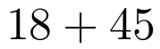
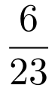
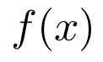
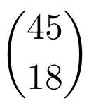
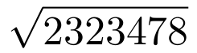
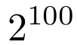
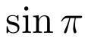
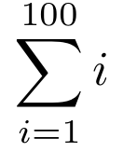
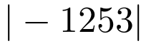



Types of Expressions
An expression describes a computation and evaluates to a value

Slide 36
Call Expressions in Python
All expressions can use function call notation
Demo

Slide 37
Anatomy of a Call Expression
add ( 2 , 3 )
Operator
Operand
Operand
Operators and operands are also expressions

Slide 38
Evaluation of a Call Expression
add ( 2 , 3 )
Operator
Operand
Operand
Evaluate
Evaluate the operator subexpression
Evaluate each operand subexpression
Apply
Apply the value of the operator subexpression to the values of the operand subexpression

Slide 39
add(add(6, mul(4, 6)), mul(3, 5))

Slide 40
Humans
We like to inside inside-out
add(add(6, mul(4, 6)), mul(3, 5))
add(add(6, 24 ), mul(3, 5))
add(add(6, 24 ), mul(3, 5))
add( 30 , mul(3, 5))
add( 30 , mul(3, 5))
add( 30 , 15 )
add( 30 , 15 )
45
Python can’t jump around in the same way we do

Slide 41
Nested Call Expression
Evaluate operator Evaluate operands Apply!
1
2
3
45
add(add(6, mul(4, 6)), mul(3, 5))
add
30
15
add(6, mul(4, 6))
mul(3, 5)
24
add
6
mul(4, 6)
mul
3
5
mul
4
6
Expression Tree

Slide 42
Functions, Values, Objects, Interpreters and Data
Demo

